Slide 1
SPEAKER
Bianca Woods
HASHTAG
#ATDTK
Everything I Ever Needed To Know About Simulations I Learned From Video Games
1 PLAYER GAME
2 PLAYER GAME
Session TH103
Notes:
Introduction (5 min)
Hi and welcome to "Everything I ever needed to know about simulations I learned from videogames". This session is all about how much the games we play for fun can teach us about making the simulations we create for training, whether they’re something as simple as teaching someone the steps for using software or as complex as letting people practice soft skills like coaching, more engaging, exciting, and effective. Now, obviously we can't cover every possible thing you could learn about the connection between sims and videogames in just one hour. But what we can do is discuss a new way of looking at games so you can make your own discoveries. I'm going to talk about some of the highlights of what absurd amounts of gaming have taught me about making more successful simulations, I'll give you some thought starters, and even give you some suggestions for videogames I found particularly helpful in changing how I developed simulations. If that sounds like what you're looking for, then you're in the right place.
Just a quick up front message: I always share my slide decks, so if you happen to miss anything along the way, I'll be sharing a weblink at the end of the presentation that you can download the deck from.
Fonts:
Press Start 2p font: http://www.fontspace.com/codeman38/press-start-2p
Nintendo Dingbats NBP: http://www.fontspace.com/total-fontgeek-dtf-ltd/nintendo-dingbats-nbp
Gamecuben: http://www.fontspace.com/bleutuna/gamecuben
Mushroom Kingdom NBP: http://www.fontspace.com/total-fontgeek-dtf-ltd/mushroom-kingdom-nbp

Slide 2
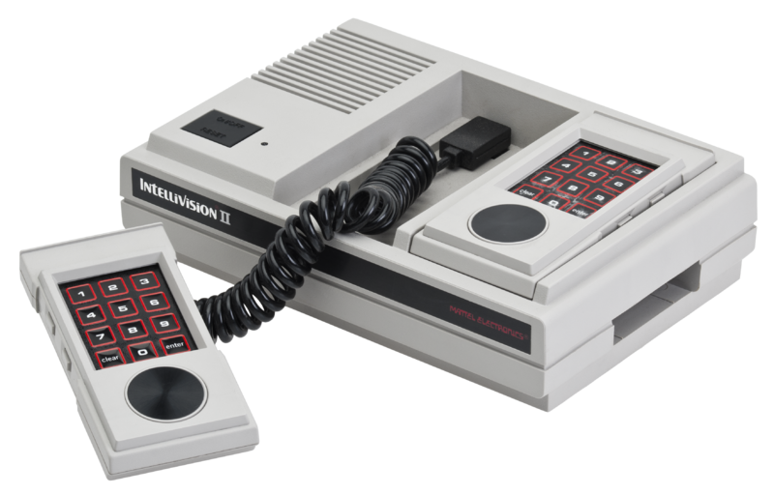
Notes:
Intro: Talking about being a gamer – game console slide (2 min)
Okay, who here remembers their first game console?
Well, I sure do: the Intellivision. I don't really know why my parents decided we needed a gaming console… I don't remember ever asking for one… but one day there it was in our home: a used Intellivision and a handful of really random games, and like any kid would be, I was curious about what the heck this new toy was all about. And so I eventually worked my way through the entire collection of games that had come with it. Some of them never clicked for me… I distinctly remember repeatedly trying to like Tron Solar Sailor but never remotely understanding how to play it (the fact that it hadn't come with an instruction manual didn't help). But others… others I just loved. I was completely obsessed with this machine that, even with terrible graphics, a weird controller, and frankly lousy sound effects, could make me feel like a race car driver or sub pilot or a character from Tron.
And so I was hooked. As I grew up I cycled my way through the different Nintendo systems, dabbled with Sega, and then jumped ship to the Sony Playstation. The systems changed, the games kept getting better, and I never stopped loving them.

Slide 3
Notes:
Intro: Talking about how when I became an ID I began to see all the connections between the simulations I was creating and the games I had grown up playing (1 min)
So that brings us to a few years ago… my Playstation 3 years. I was back in school learning how to be an instructional designer and I got really into the idea of training simulations. And the more work I did on finding out more about simulations the more work I did learning to make my own the more I realized this: games and training simulations are fundamentally similar things.

Slide 4
Player-driven
Learn from mistakes
Recreate situations
Immersive
Notes:
Intro: What games have in common with sims for learning: Player-driven, Learn from mistakes, Simulate situations, Immersive (1 min)
Sure, games are for fun and training simulations are trying to teach you something or test your knowledge, but at the end of the day they have so much in common. Both are player-driven experiences. Both encourage you to learn from mistakes and try again until you succeed… as pretty much all of us who have died over and over again in the same part of a game can attest to. Both are trying to recreate experiences, whether they're real or completely fictional. And both, when done right, make you feel completely immersed in the world of the experience, whether it's the completely imaginary Tron disc contest on my old Intellivision or a true to life simulation that teaches you how to do your job better.

Slide 5
1
Level | Who’s your audience & what’s your genre?
Level | How much choice does your player really have?
Level | How do you avoid the uncanny valley of sims?
Level | How does prototyping save you time?
Level | How does iterative design add polish?
Level | What do you gain when you play with a friend?
2
3
4
5
6
Notes:
Intro: We have a lot we can learn from games to inform how we create sims - What we’ll be talking about today (1 min)
And so that means that when we design and develop simulations for training, we're not creating this brand new art form. It means we're treading a similar path to what game developers have been traveling on for years. And what that means is we don't have to reinvent the wheel. We can learn from what game developers have been figuring out how to do well for years.
And that's what we'll be exploring today. I picked out a few of the more complicated challenges that we face when we design simulations for training and we'll take a look at how game developers have been solving these exact same problems in the work they do.

Slide 6
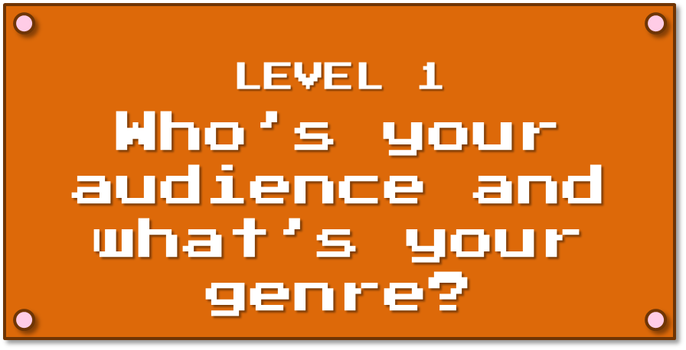
LEVEL 1
Who’s your audience and what’s your genre?
Notes:
Topic 1: Identifying your audience and structure (10 min)
One of the initial things a developer needs to think about is what kind of game they’re making and who exactly they’re making it for.

Slide 7
Shooter
Casual
Visual Novel
Massively Multiplayer Online (MMO)
Role Playing Games (RPGS)
Puzzle
Survival Horror
Platformer
Sports
Adventure
First Person Shooters (FPS)
Fighting
Strategy
Rhythm/Music
Simulation
Racing
Sandbox
Notes:
Topic 1: The first thing you notice when you play games is there are a bunch of types– Talk about genres (and my favourite) – (1 min)
So let’s deal with the first part of that question: what kind of game. If you’re ever played more than a few video games you’ll notice that they don’t all play the same way. Some focus on plot, others skew more towards just blowing stuff up. Some are quick games you can play while waiting in line, others take hundred of hours to complete. You get the picture. Basically, video games are just like any other media in that there are different genres of content that things get organized into. Just like movies can be organized into action, drama, comedies and such, games have their own types of genres. I’ve got a bunch of examples of the most common types here on the slide, but there are even more than just these.
These categories tell you a little bit about what you can expect from your experience. If I pick up a fighting game, for instance, it’s not going to be identical to all other fighting games, but chances are I can expect there will be a bunch of different characters I can choose from to play, all of which use different fighting styles. I can also expect that to control these characters I’ll use a series of button combinations to trigger specific fighting moves. If I’m good, I’ll memorize those combinations. If not, I’ll just mash the buttons randomly and hope for the best. Okay… fess up… are there any button mashers in the audience? Full disclosure… when it comes to fighting games, I’m more than a bit of a button masher.
The fact that there are so many game genres shows that developers have figured out something pretty important about people: they don’t all want the same experience.

Slide 8
Notes:
Topic 1: So game developers don’t assume all players want the same thing. But lots of people make sims without sitting down to figure out who their target audience is. They try and make one thing that will be valuable to everyone, which is a mistake. So we need to do what game developers do: we need to figure out who exactly we’re making the sim for and what kind of experience that audience will want. (2 min)
Because game developers know people have different tastes, they put a lot of time, energy, and money towards determining who the target market for their game should be and what they want in a game experience. The mistake our industry sometimes makes when we’re creating training simulations, though, is skipping that step. Instead, we go the route of a cookie cutter sim, one kind of experience for every single simulation we’re trying to create.
For instance, not naming any names, but once I was checking out a training library that included a sim at the end of each lesson for you to practice your new skills in. I love sims, so I was pretty excited about this. So I finished my first lesson and was kind of giddy about starting up the practice sim. I got to play out an office situation and use my new skills to respond to emails and co-workers. The situation was a bit too easy for me, but the interactions were rather spiffy and all seemed to work well with the content.
So far so good, I thought, so I took a lesson on a different topic. I got to the end, started up the lesson’s sim, only to find it was the exact same sim, just with the content changed. I kid you not, the screens were reused, the interactions were almost all the same, the simulation followed the exact same structure, and in this case it didn’t work at all with the content. In the second sim, I didn’t feel like I was testing my knowledge at all, because what I had learned didn’t actually connect well to the situation in the sim. It just felt forced… and more than a bit boring since I had just done a near identical sim so recently. Then I checked their other lessons and found they had done the same reuse-a-sim in them too.
So that’s an extreme example, but it really shows how you just can’t do the same thing over and over and expect your audience to get something out of it. It also shows how little this developer had taken their audience into account when they were designing the sim. First, I can’t have been the only one who found that first sim way too easy. Second, did they not think that people were going to take more than one lesson from their library? Even if the content from each lesson had suited that type of sim, it was still going to be dreadfully boring to do the same kind of experience over and over again.

Slide 9
What do you know about me?
Age
Experience level
Other games I like
Other games I hate
What gameplay do I find fun
How challenging do I want my games
How much time do I have to play
What do I play games on
Do I like to play with friends
How do I find out about new games
What reviewers do I trust
Where do I buy my games
Notes:
Topic 1: Creating an audience profile. Compare what a game developer might ask to what a sim developer would need to know). Talk about how this isn’t a spot-on description of every single player, it’s just an average. When you know who your real audience is, then you can develop for what they really need. – (2 min)
So before you start working on your sim, you need to do what any game developer would do: paint yourself a clear picture of who you’re making this thing for. Some game devs do this simply. I saw a game on Kickstarter recently where the dev simply said that he wanted to design the game for people who liked the traditional survival horror games from the 90s. Other people just design a game for themselves and hope it finds an audience with people like them.
In our case, though, we know we’re designing for a specific need, so it’s better to follow the lead of big game studios and go with something a bit more detailed. They need to know exactly who they want to target their game at for a lot of reasons. From a strictly business perspective, you don’t want to make an expensive game that only has a small number of people who’ll actually want to play it. They might also want to target a specific kind of customer, perhaps one that they know has lots of disposable income or isn’t being well served by other games on the market. I know that sounds a bit cutthroat, but at the end of the day it’s very similar to what we need to do with our sims because in our case we know we’re targeting a specific group of people for our sims, and we want to make sure we’re meeting their needs.
So a game developer is going to need to answer a bunch of questions about their audience, and I’ve got a sampling on the screen here of some of the once they might use. Essentially, they need to use questions that’ll tell them more about what this audience wants and expects from the kind of game they want to spend their money and time on. What experience do they have with games, what kinds of game play do they like or hate, do they want to play on their own or with friends, how long do they expect their games to be, how much time to they have to play in one sitting… questions like these help shape a game to be what that audience wants the most.
Now, obviously their answers to these questions won’t describe every single person who’ll end up playing the game, it’s just an average. But that average is a much better way to guide developing a game than knowing nothing at all about your audience and hoping for the best.

Slide 10
A learner profile could look like…
Audience for a tech training sim
In 20s-30s
New to role
1-3 years of experience with the company
Tech savvy
Experienced with playing sims
Basic level understanding of the topic
Typically learned about this topic on the job
Previous training left gaps in understanding
Has an older desktop computer (no sound)
Does have time for longer simulations
Has access to company social network
Enjoys self-paced learning
Audience for a leadership sim
In 40s
In role for at least 3 years
Has a current laptop and iPad
Limited time to complete training
Incredibly busy schedule
Training is to prep them for executive roles
Has a deficit in leadership soft skills
Is excited about the training
Has had bad experiences with eLearning
Would not classify themselves as a gamer, but enjoys casual iPad games
Very comfortable with iPads, but not as much with PCs
Notes:
Topic 1: Show some sample audience profiles. (3 min)
So in our case our industry has a technique that’s rather similar: a learner profile. Just like in the gaming world, it’s a way for us to describe our average audience for the training we’re creating. They do a lot to help you ground any kind of training you create in your audience’s real world and real needs, which leads to training that people find more helpful and practical.
Just like game developers, you’re going to be putting together an average picture of your audience. So you’ll build a profile but you’re going to be answering a different set of questions than a game dev. I tend to find that every project requires a slightly different set of questions to get to the bottom of things, but in each case these questions should help you learn more about your audience’s experience with the content, what they need to do differently after the sim, what kind of sim they’ll get the most out of, and how they feel about training. If you’re creating a digital sim, you’re also going to need to know more about the tech they have access to and what their comfort is with is. I’ve actually got a list on the resource website for this talk of some sample questions you can use to begin building a learner profile.
So here’s one example of a basic learner profile, but even this short profile can do a lot to guide me. For instance, I know this audience typically doesn’t have sound on their computers, so if I’m doing a digital sim I know not to waste time on voiceovers. I also know they’ve done sims for training before. That means I don’t need to include a lot of content that teaches them how to use a sim itself. They’ve also had training on this content in the past, but it was patchy. Maybe I should find ways for them to skip what they already know?
(cue animation)
Now, here’s another learner profile, and it’s quite a bit different. If this is my target audience, I can see that they have limited time, so no multi-hour sims here. I also know they’ve had some bad experiences with eLearning, but do enjoy casual games. I’m probably going to want to make thing look more like a game and less like eLearning to keep them happy. Making the sim playable on a tablet could be a smart idea too.
These are the kind of insights you can get from a learner profile.
So how do you find out this information? In some cases, you might know your audience personally, so you can answer these questions yourself. If you’re working with a SME, they can often be a good resource to tap as well. If you have the opportunity, doing surveys with a small cross section of your audience and sometimes even their managers can be incredibly useful. Also, previous test scores and performance reports can tell you a great deal. It’s not quick work, and it often requires a bit of detective work, but it pays off in the end.

Slide 11
Learner Profile
In 40s
In role for at least 3 years
Has a current laptop and iPad
Limited time to complete training
Incredibly busy schedule
Training is to prep them for executive roles
Has a deficit in leadership soft skills
Is excited about the training
Has had bad experiences with eLearning
Would not classify themselves as a gamer, but enjoys casual iPad games
Very comfortable with iPads, but not as much with PCs
What does this tell me about what kind of sim is best for both this training issue AND audience?
Notes:
Topic 1: So use the information you learned from the audience profile to tell you what kind of sim experience will work best for this audience. Look at what they need to get out of the experience, what knowledge level they’ll come in to it with, what training issues they’ve had in the past, what kind of device they’ll be accessing the sim on, etc. Then design a sim that meets those specific needs. (1 min)
Now comes the next step: deciding what style of sim you need to make. The content you’re working with will guide you here, but the people you’re designing for should also influence your choices too.
Here’s where that learner profile comes in. You can use what you know about your average audience to tell you what kind of sim experience will work best for them. Then find a genre of sim that both fits your content AND what you know about your players.

Slide 12
I have no time, but I do have a smartphone
=
A phone-based sim that can be played quickly
I’m a beginner and like learning by watching others
=
A sim that lets you watch someone else and then try it yourself
This topic has a lot of gray area
=
A story-based sim that has branching choices
Notes:
Topic 1: Examples – you know they’ll be accessing it on a tablet in between clients: Something that can be played quickly. They have basic skills and prefer to learn through watching others: use a software simulation that demonstrates the skills one by one and then lets them try it out. Complex skills with a lot of grey area instead of cut and dry answers: try a branched sim that’s story-based. (1 min)
Maybe you know your audience travels a lot, so they don’t have large blocks of time to sit down for training. But they do have a lot of short breaks… and they do have a smartphone. Then a sim they can play in short bursts on their phone is a smart fit. Maybe your investigations taught you that your audience is brand new to a task and likes learning through watching someone else? Then perhaps a combination of watching an expert do a step themselves and then letting the player try to replicate it is the best fit? Or maybe your content is on soft skills… sims that are story-based and involve a lot of branching choices can be a great fit for recreating complex conversations that have more that one right path to success.
So, to wrap this up what we can learn from games here is that you want to know who your target market is for your sim and then design that sim around their needs.

Slide 13
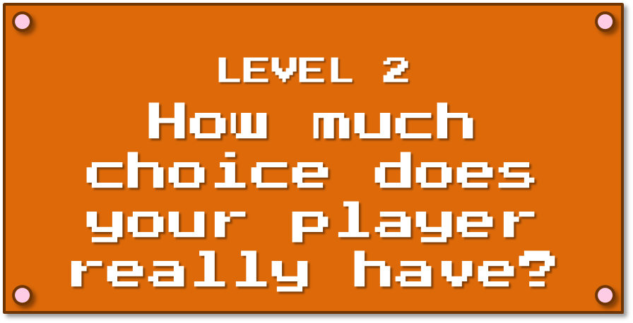
LEVEL 2
How much choice does your player really have?
Notes:
Topic 2: How much choice does your player really have?(7 min)
While we’re exploring the variations of games and sims you can create, let’s look at a topic that’s key both: how much choice does your player really has in the experience. How much do they control what happens or how they progress through the story?
Whether it’s a game or a sim, choice shapes what the experience is for the player and what they get out of it.

Slide 14
Linear
Pretty much just one path to the end
Level 1
Level 2
Level 3
Level 4
Level 5
Notes:
Topic 2: Talk about range of choice in video games: Linear (JRPGs, Mario, The Last of Us)(1 min)
In videogames, designers typically go with a variant of one of three models for choice.
First up is a linear game. All players progress through the game in pretty much the same order. If you’re playing a game that has levels, chances are you’re playing a linear game. You start in one section of the game and can’t move on to the next one until that section of the game is complete. Some games are really strict about this, like the original Super Mario games where, aside from a few cheats and hidden shortcuts, you had to go the exact same way through the level as everyone else. Other games are less strict. One of my favourite games that I played last year, The Last of Us, gave you a bit of wiggle room in the order you did things, but not a lot. Areas opened up when you accomplished some tasks, and then closed off when you were done with them. And, at the end of the day, your choices didn’t change the story.
In sims, the linear set up is commonly used in any situation where the order people do things in is incredibly important. Software simulations, paperwork, processes… anything that has to happen a specific way for it to be correct.

Slide 15
Some choice
You have some degree of choice in choosing your path to the end
Choice A
Choice
Choice B
Choice C
Notes:
Topic 2: Talk about range of choice in video games: Some choice in events, but still linear storytelling (The Walking Dead, Mass Effect) (2 min)
The next option is to give your player some choice in how the story or game progresses and concludes. This means multiple paths to the end and often means multiple endings too. The player has the ability to change what they see in the game to some degree, and so two people can play the same game and have different journeys in it. A great example of this is the first season of The Walking Dead videogame. Seriously, if you only play one game to learn about creating sims, let it be this one. This game has some of your expected zombie killing, but most of it is simulating group dynamics in a crisis. The vast majority of how you play this game is simply by choosing what to say to other characters. Your gameplay influences not how many zombies are dead… it changes how the people you’re with work together and react to stress. Obviously not every single choice you make in this game can change the story, but enough do that you feel you’re in control.
In sims, you’ll often see this kind of choice in soft skills sims. It’s great for recreating situations where there’s more than one right path (or more than one wrong one). It’s also perfect for simulating situations where a sudden wrong choice can mess everything up, or a right choice can drastically improve everything… things like coaching or customer conversations.

Slide 16
Open World/Sandbox
You have constant opportunities to choose any number of paths
There may even be no final “end”
Notes:
Topic 2: Talk about range of choice in video games: sandbox/open world games (Minecraft, Grand Theft Auto, SimCity) (1 min)
Finally, the last option is to let your player do things pretty much however they want. These are called open world or sandbox games. This means that some or all the the gameplay is just giving the player a world to be in and a selection of ways to interact with it and just letting them do what they please in that environment. Some games have this as part of the experience, for instance the Grand Theft Auto games essentially gives you a city to explore, but there’s also a more linear storyline you can choose to follow if you feel like it. If you’re me, though, you’ll probably just skip the story and spend the entire game stealing cars and driving like a maniac. Then there are games like Minecraft, which have no real “end”. Actually, Minecraft is more like a super complex set of Lego that you can build with and explore.
In sims, you might see open worlds as an overall structure for content that can be completed in any order. I saw it used for an onboarding program, where the player was exploring a new office and could interact with different with different characters in the office to learn more about what working there was like. It’s also great for sims where you create things, for instance those programs that let you arrange furniture in a room so you can test different layouts.

Slide 17
How much choice is right for your project?
One option:
Pick based on how skilled your audience already is with the content
Skill Level
Linear
Moderate choice
Open world
Notes:
Topic 2: Think about which of these choice options makes most sense for your sim. For instance with a software sim, the amount of choice you choose could be based on the player’s skill level. Linear for beginners, some choice for intermediate, and open world for experts. - (1 min)
Just like every game, ever sim needs to have some level of choice in it. But how to you decide what’s the right amount? There are a number of ways to make this decision, but here’s two I find work well.
First, you can let your audience’s skill level determine things. The higher the skill level, the more choice you give them. So beginners would get a linear sim that’s simple, gives them guidance, and is easy to follow. Experts would get a more challenging and less-structured sim that has more choice points so they can choose the path they take and the experience they have.

Slide 18
How much choice is right for your project?
Another option:
Let the experience you need to recreate guide what you pick
Creative Commons Icons - Dan Hetteix
http://thenounproject.com/term/landscape-architect/23837/
http://thenounproject.com/term/welder/23847/
http://thenounproject.com/term/biohazard-team/23835/
Notes:
Topic 2 – Another example – Using the type of experience you need to recreate dictate your choice. If you wanted to do a customer service simulation that encompassed a full day’s worth of events, open world would be closer to reality. However, if you wanted to tackle a more narrow and more story-based skill, such as how to talk with an angry customer, a linear sim would make more sense. – (1 min)
Another option you have is to base the amount of choice on what more closely resembles the kind of experience you’re trying to recreate. If you need to simulate a data entry program, chances are the real world version of that is more linear, so it makes sense for your sim to be linear as well. If you need to simulate a conversation with a customer, though, the real version of that experience can go any number of ways but will always have a distinct beginning and end, so a sim with some choice and branching would be closest to the real experience.
So, to summarize, the amount of choice a person has, whether it’s in a game or sim, shapes what they experience is like for them. You can influence what that experience is like by being deliberate about how much choice you give your players.

Slide 19
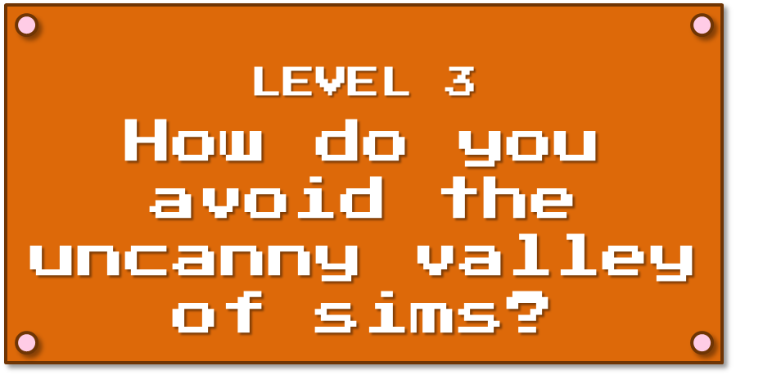
LEVEL 3
How do you avoid the uncanny valley of sims?
Notes:
Topic 3: Uncanny valley of simulations (5 min)
Next up is a concept that’s commonly applied to game visuals that I think has a way of applying to the sims you create too.

Slide 20
The uncanny valley
Healthy
person
Considered creepy
Slightly humanoid robot
Familiarity
Creepy bad CGI
Hyper-realistic android
Industrial robot
Human likeness
Zombie
Corpse
Notes:
Topic 3: Talk about what the uncanny valley is in CGI (1 min) http://www.strangerdimensions.com/2013/11/25/10-creepy-examples-uncanny-valley/
http://www.buzzfeed.com/danmeth/welcome-to-uncanny-valley
So here’s a concept you may have heard of: the uncanny valley. It’s a common concept in both games and anything else that involves a lot of CGI. Basically the concept is this: People are find with things that look human-ish, you know, like a basic robot. They’re also fine with representations of people that look spot-on… like really good CGI characters in more recent movies or games. But there’s this weird little window when something looks almost exactly like a real human being… but not quite… like dolls, androids, zombies, corpses. This “really close, but just a little bit off” freaks people out.

Slide 21
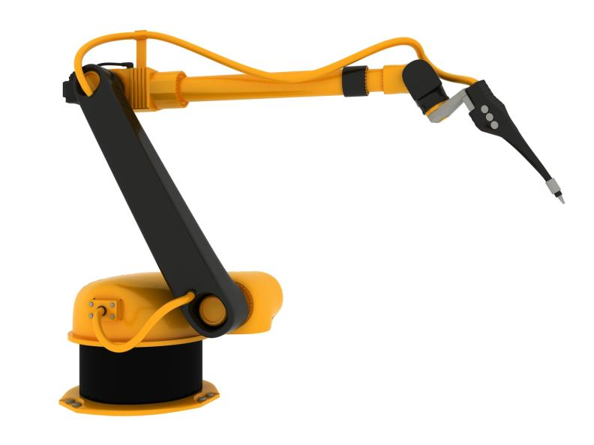
Creative Commons photo credit: Nathan Alderman
https://www.flickr.com/photos/nathan_alderman/2257092340
Creepy or not creepy
You be the judge
Notes:
Show some examples “Creepy or not creepy”– (2 min)
So let’s take a look at this with a game I’m going to call “creepy or not creepy”. I’m going to show you a picture of something sort-of human, and you can tell me if you find it creepy or not. So let’s start with this robot arm. Raise your hand if it creeps you out.
(cue animation)
Now let’s get slightly more realistic with this more humanoid robot. Raise your hand if you find this one creepy.
(cue animation)
Alright, moving towards even more realism, here’s a robotic child. Raise your hand if you find this creepy.
(cue animation)
Alright, let’s try an android that’s trying to look like a human being. Creepy?
(cue animation)
Then how about these kids from the movie Polar Express. Creepy?
As we saw here, if something is close to human, real people tend to find it off-putting and really distracting. This is a huge challenge that’s being faced in the world of videogames right now. Now that our graphics are so good, many game companies want to go for realism in games. But it’s still hard… really hard to make a digital face seem realistic. Often it gets most of the way, only to have dead eyes or facial muscles that don’t quite move right, and it seriously creeps out players.

Slide 22
The uncanny valley in sims
When something’s really close to reality, but not quite right…
Notes:
Talk about uncanny valley in sims – feels REALLY close to reality, but a few key things are off, which pulls the player out of the sim and makes it less immersive – (2 min)
So what the heck does this have to do with sims? Well, the more I heard about the uncanny valley in games, the more I realized it had it’s own equivalent in games. We don’t have to worry as much about making perfect CGI just yet, but we have another realism issue that can distract and irritate our players: how close we replicate their real environment. I want you to think to yourself: have you ever played a simulation, or even done any other kind of training, that was really, really close to your real situation, but then got one thing painfully wrong? Maybe a character was talking with you, and suddenly used a job title that you know your company doesn’t have? Maybe you were interacting with a software simulation and it was great until you noticed it had a green button where a red switch should be? Perhaps it was a customer service sim and the customer suddenly used a term or phrase that only employees use. Wasn’t this really really distracting?
Part of what makes this so especially irritating is the fact that this simulation was so very close to the world you know so well, but it was just every so slightly off at one point. On paper these small errors don’t sound like much, but when you’re trying to immerse a player in a world, it’s these little details that pull them out of it. This is the uncanny valley of simulations, and you want to avoid it at all costs.

Slide 23
Two options for avoiding the uncanny valley of sims
Fictional situation
Duplicate reality
Notes:
Topic 3: You need to make one of two choices: make it set in a hypothetical situation OR do a lot of great research and do as accurate duplication of reality as possible – Show two options (1 min)
So how do you do that? You’ve got two real options: either back completely away from reality or devote yourself to creating a perfect replica.
With the first option, instead of trying to replicate reality, you’re going to create a fictional world and a fictional situation. If we’re comparing this to games, this is like being Super Mario or Pokemon: the game designers clearly aren’t even bothering to strive for realistic characters or scenarios. Because it’s no longer trying to replicate reality, this means your players won’t get distracted if something isn’t exactly like their life. It’s a made up situation… they aren’t expecting hyper reality. This obviously won’t work for situations that need to be exact and precise, like a sim that’s teaching someone to use a specific tool or piece of software. But it can be great for soft skills like coaching.
The other option is aggressively trying to replicate reality. From a game perspective this is like high budget games like The Last of Us, where they want the characters and environments to look as real as possible. You need to make sure your sim has none of the little errors that land it in the uncanny valley of sims. This means you’re going to need to do a boatload of reasearch up front. It also means you’ll likely want to play test it with a sampling of SMEs and your actual audience members to catch anything you might have missed. But this attention to detail can really pay off if realism is what you need.

Slide 24
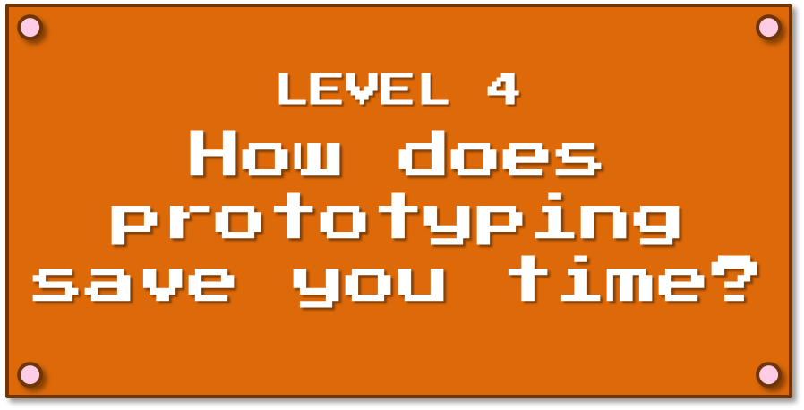
LEVEL 4
How does prototyping save you time?
Notes:
Topic 4: Prototyping (5 min)
Okay, so here’s something that’s a core part of every game that’s developed, and one we could definitely learn from when we build sims: prototyping.

Slide 25
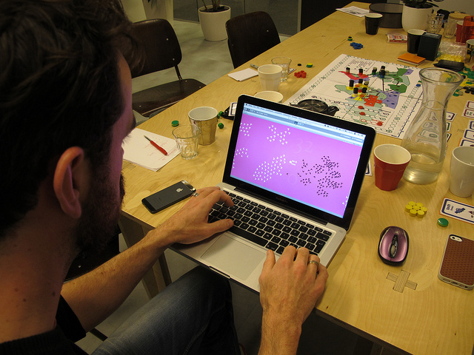
Games often begin as a prototype
Creative Commons photo credit: Kars Alfrink https://www.flickr.com/photos/kaeru/11046883834
Notes:
Topic 4: Talk about how game developers don’t just start coding perfectly coded games, they make rough copies and mockups first. These prototypes can be digital, or they can be physical (bring up example of setting up a physical version of the field in a shooting tutorial). Making a rough version of your plan allows you to test and see if it does what you need it to, or even find out if you like the experience of it at all. It also saves game studios a ton of money because prototypes are much cheaper to create than the finished version. (2 min)
No game springs fully-coded from a game dev’s forehead. Also, like a lot of work, a game dev’s first idea about what a game should be and how it should work can change drastically over the course of development. Maybe an idea that sounded good on paper just isn’t fun when you actually play it? Or maybe something that sounded cool in your head just comes across as confusing when you show it to someone else. There are just so many choices and so many things that go wrong… and finished games take so long to complete.
That’s why game developers do a huge amount of what’s called prototyping. Basically, it’s the gaming equivalent of rough copies and mockups. You start with something that’s quick and cheap to make that you use to test a concept. Maybe it’s dots on a screen like you can see right now that you use to figure out your coding for how swarms of enemies should move. You can polish the graphics later, but what’s really important now is to figure out how to get the movement of the swarm to work right. A prototype allows a developer to not invest too much time in something that might not work, and it also allows them to concentrate on just one aspect of the game without having to worry about trying to polish everything at the same time.
Prototypes don’t all have to be digital too. I’ve seen prototypes with paper that layout the basics of a screen map. I even saw a talk once where a gam dev was telling us about a level tutorial he was designing. He made a kind of hilarious diorama of the environment and then filmed moving through it, which allowed him to test if the tutorial looked and felt right… kind of like a video storyboard.
At the end of the day, prototypes let developers test out ideas and work out problems quickly and comparatively cheaply.

Slide 26
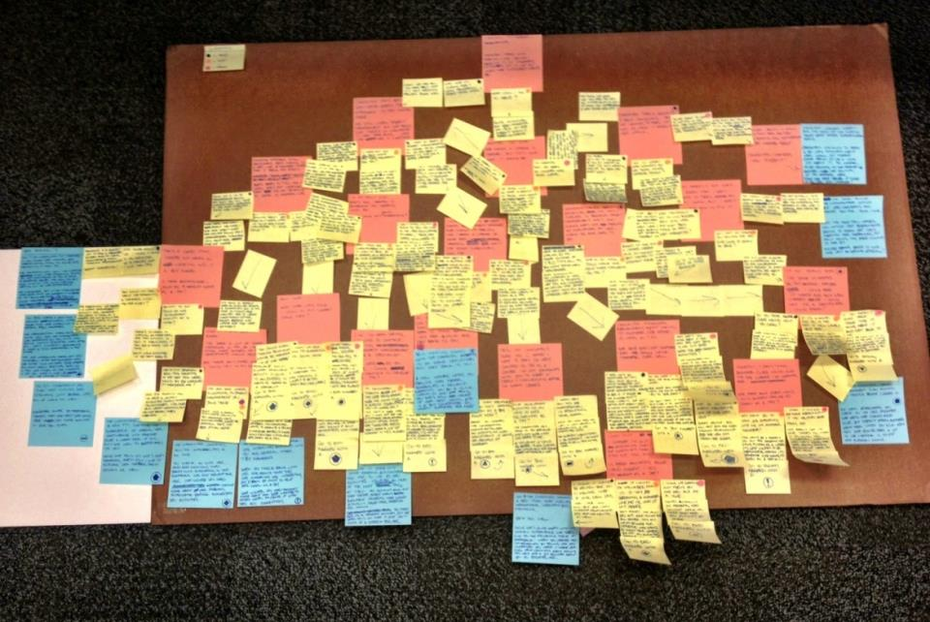
Building a sim prototype
Post-it Notes may become your new best friend
Notes:
Topic 4: Sims are hard to create, so cheap mockups will save you a ton of time and effort. Talk about ways you can make sim mockups (post it notes, choose your own adventure style books, PowerPoint with hyperlinks, video of you reinacting what will happen in the sim, storyboarding) – (3 min)
Sims are a lot like games in that they’re time consuming to create… and often kind of pricy too to create as well. You don’t want to spend weeks and weeks creating a sim only to find out it’s buggy, or one of the storylines doesn’t make sense, or a interaction you thought was intuitive actually confuses players. Or, worst of all, you build the whole thing and whoever is signing off on it somehow imagined it being completely different from what you actually made. Cheap prototypes are a great way to avoid all this pain. It works for game development, and I really think it works for us too.
There are some pretty basic ways you can make mockups for a sim. One thing that I’ve used a lot is post-it maps like you see on the screen here. I was creating a bunch of branched simulations on career conversations. It was one of those sims where storylines could loop back into each other, so it was really important that I made sure those loops made sense. I also needed to be able to quickly look at my work and make sure all my storylines had covered the wide variety of things that could happen in this kind of conversation. So what I did first, before I even started scripting, was make a prototype map of every story branch and every choice. Each of those post-its represents a summary of a screen of content or a choice the player could make. Only when I was happy how everything in this map all worked together did I actually start creating the in-depth script.
Another prototype I made for this same project was a quick and simple version of the conversation simulation. My SME and I needed to get the content signed off on before we started investing a lot of time in the look and feel of the sim, and long before I started using the software to create it. But this was a really tricky project to review the script for because of the branching. It was also hard for people who hadn’t ever done branching simulations to understand. So I put together a mockup in PowerPoint. Each slide could represent a screen of sim content, and I used hyperlinks to simulate making choices and seeing results. I created super basic images… in this case just a stick guy with either a smiley or frowny face based on how well you were doing in the conversation, and just let them focus on the text for now. It was quite fast to create, and it gave reviewers the sense of how the sim would work without investing a huge amount of time and money into the final look at feel… so if they hated sections and I had to change things, it wasn’t like I was throwing out a ton of work.
So those are two ways you can put together a protoype, but there are tons of others too. Seriously, do the same things game devs do: try a paper version, or a choose your own adventure style book, draw storyboards, or make a mockup in PowerPoint, or film you reinacting scenes on your smart phone. Anything that will let you test out your concepts quickly and cheaply. This saves you time, and also gives you room to experiment and potentially fail at a low cost.

Slide 27
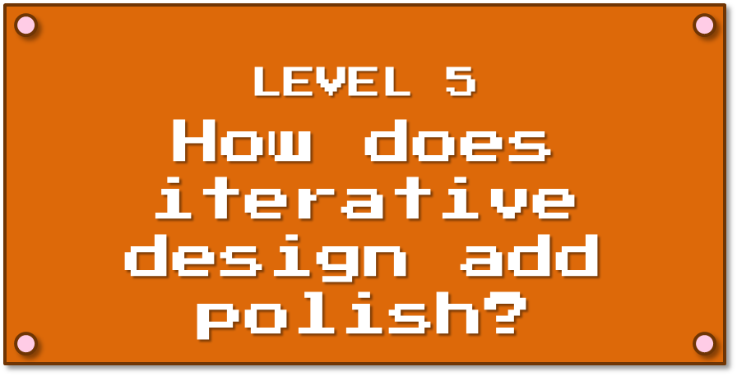
LEVEL 5
How does iterative design add polish?
Notes:
Topic 5: Iterative design (5 min)
Now, let’s move on to a related topic. Let’s say you’ve got the basics all sorted out. Now how do you add polish? And how do you keep improving things? Well, game development uses a technique called iterative design.

Slide 28
Not how games get made!
Notes:
Topic 5: Video games also don’t get programed and magically work exactly as planned. (1 min)
Like I mentioned earlier, games don’t magically turn out exactly how they’re planned. Sometimes you have to try things a bunch of different ways to make it work. Other times you get one thing working, but that breaks something else. There is a huge amount of constant polishing and reworking throughout the entire development process to get things right.

Slide 29
Games use
Iterative Design
Notes:
Topic 5: Explain iterative design as a concept (1 min)
This gist of this process is called iterative design. Think of it like the evolution of Mario up here. First he started out all blocky, because that was sort of the best you could do on the Nintendo at the time. Then the gaming hardware got more powerful. Game developers didn’t just leave Mario looking the way he always had… they had the opportunity to improve him, so they did. And this was done pretty much every time a new game came out, and definitely every time a new console launched. Until eventually Mario evolved into a character that looks rather different from where he started out. This long process of tweaking and tweaking and polishing kept adjusting to the new reality developer were working in, and kept making a better and better Mario.

Slide 30
Alphas, betas, and playtesting
Tediously working out the bugs
Notes:
Topic 5: Talk about player testing, alphas, and betas. Talk about development story of tutorial for game (possibly show video of an alpha) – (2 min)
This kind of constant repolishing doesn’t just happen over the course of dozens of games. It happens many times during the development of every game. Game developers use rough builds of their games, called Alphas if you’re in the early stages and Betas if you’re close to finished, to work out game bugs and make sure everything works exactly the way they want it to. These versions of the game are substantially more complete than a prototype and often test out how many of the game aspects all work together (or don’t work together if the alpha or beta doesn’t function quite right). And these alphas and betas are played by the true heroes of the gaming industries: playtesters. Yes, these are people who either volunteer or are paid to play a game the developer knows needs work still, and they then give their feedback, in many cases, super detailed feedback, to the developers so they can fix problems and polish games even further. A lot of studios even video their game play so developers can see what’s happening. This sounds fun, but is really one of the most tedious and awful jobs you can get in this industry.
What’s interesting is that this cycle doesn’t just happen once. It happens over and over and over again until all the bugs are out of the game (or at least all the bugs the developer doesn’t want the game to ship with) and it all works the way the developers intended. In a lot of cases, this process doesn’t even end after the game had shipped, as any one of us who’s had to install a game patch knows. Developers will sometimes fix problems with the game even after it’s considered done. It’s a long process, but this constant cycle of small, incremental changes and updates is what makes something as complicated as a game possible to produce.

Slide 31
The path to a great sim
isn’t a straight line
Eventually you end up with a finished sim
Create a rough build
Playtest
Revise and polish the sim
Review feedback
Notes:
Topic 5 – Talk about how sims need to do this kind of testing and polishing to be most effective. Discuss building in time for non-sim developers to test the sim to find bugs, inconsistencies, and places where the sim doesn’t teach the material as effectively or doesn’t connect with the audience. Easier for non-designers to find. Don’t skip this step. (2 min)
Sims are one of the most complex things we can create in our line of work, but we sometimes take this approach of just designing the thing, building it as designed, testing it out briefly, launching the thing, and never touching it again. I think the way to create a truly great sim, and to keep it truly great, is to always use iterative design techniques. It’s less of a direct route to the finish line, but I think that being okay with polishing, then testing, then polishing and testing and so on leads to a much stronger simulation that feels more real and has less bugs.
In particular, I think it’s incredibly important to build in time for non-sim developers to playtest your sim, ideally try and get people from your target audience, but at the very least get some people that weren’t involved in building the sim at all. I kid you not, they’ll find bugs, inconsistencies, and places where the sim doesn’t teach the material as effectively or doesn’t connect with the audience faster that you ever could, because they have no expectations of how the thing actually should work.
I also think we could stand to take a lesson from game developers about not always considering a shipped product done. Sure, you don’t want to overwork a project and you don’t want to waste time, but if you have the opportunity (particularly if this is something you’re developing internally) it can be worth your time to eventually revisit a sim and tweak it again based on user feedback, or even changes that have taken place in the content since you originally developed it. It’s also smart to use iterative design when you make your next sim. Use what you learned from making a first sim to make the sequel even better. Just like the game devs who created Mario never stopped innovating, neither should you.

Slide 32
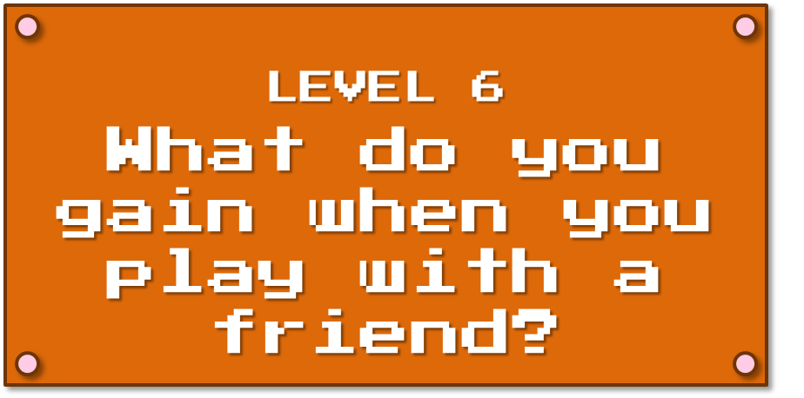
LEVEL 6
What do you gain when you play with a friend?
Notes:
Topic 6: Learning from other players (5 min)
Now I want to talk about something that happens after game development is done and the completed game is out in the world: the social debriefing of a game that a lot of players do with friends.

Slide 33
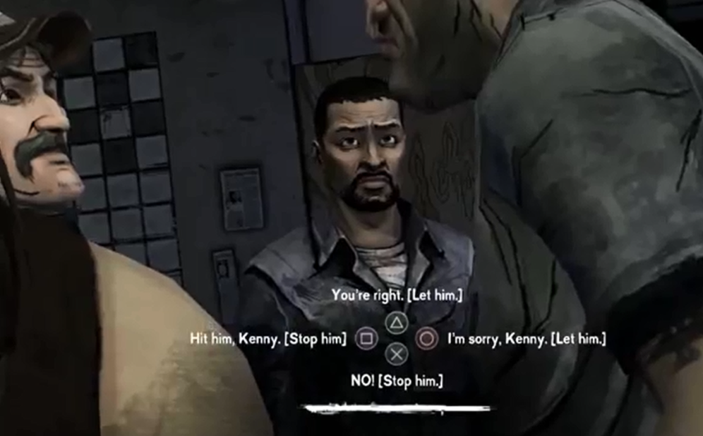
The Walking Dead
What happens when 3 coworkers play the exact same game?
Notes:
Topic 6: Talk about playing the Walking Dead and comparing my experience with Andrew and Angela (2 min)
So here’s a great example of this from my own gaming life. One of my all-time favourite games is The Walking Dead Season 1. I adore this game, partially because it’s almost constant choice making… yeah… the branched simulation nerd in me was all over this thing. Basically, a lot of the gameplay looks like what you see on the screen now. My character, Lee… the guy in the background there… was contently in conversations with the other survivors, and I got to choose what he said or did through picking from one of the 4 options I would see on the screen. Okay, that doesn’t sound super engaging, but it really was. The options would often be pretty different, a lot of the time there wasn’t a “right” choice, and I instead got to figure out who I wanted Lee to be by making these choices. Plus, quite a few of the choices you make in this game end up affecting how the story plays out.
So I loved this game, and I was delighted to find someone I worked with who also loved this game: Andrew. And we talked about the game at length, because as it turned out he had played it quite a bit differently than I had, and so they story he had seen as a result was quite different as well. Through talking to each other and comparing and contrasting our play throughs, we were better able to understand the real implications of the choices we had made.
It got even more interesting when I convinced another coworker, Angela, to play it too. She got really into making Lee her own character, and her Lee and my Lee were pretty different people. My Lee was honest to a fault… in fact, there were more than a few situations where I probably had him share more than he really should have. Her Lee was kind, but really willing to lie if it made the people around him feel happier or safer. Angela and I ended up having this amazing conversation about what it was like to play Lee so differently and what we thought our playthroughs said about us as people.
And I’ll say this, I’ve been a gamer for most of my life and I love these conversations that I’ll have with other people who played the same game as I did. On more basic games these conversations tell me new ways to beat levels I got stuck in, or help me see the game in a new way. For more complex games, though, we’ll do the sort of debriefing that Andrew, Angela, and I did and get way more out of the experience than I would have otherwise. And I know I’m not the only gamer who does this.

Slide 34
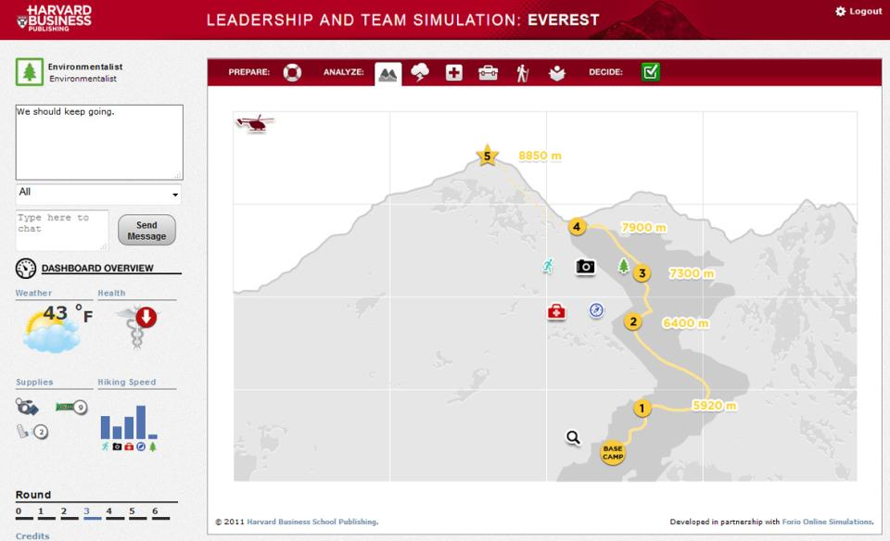
Leadership and Teamwork Sim: Everest
Forio and Harvard Business School Publishing
Notes:
Topic 6: Compare to the Everest simulation – Screen shot of Everest (1 min)
http://forio.com/store/harvard-everest-leadership-teamwork-simulation/
What’s cool is I’ve seen this sort of post-game debrief learning happen with simulations as well. One in particular is this one: the Everest sim. It’s a teamwork simulation where each player plays one character in a team that’s trying to scale Mt Everest. They each have a unique role (leader, photographer, environmentalist, and so on) and each role has it’s own additional information and goals beyond just the team ones. They all have to work together to make it up to the top of the mountain and get through a number challenges that require them to pool their knowledge and resources. And it is not easy to have the team succeed as well as the individuals.
So the sim itself is interesting, but when I’ve seen this in the classroom it’s actually the debrief that happens after that teaches everyone more about teamwork and leadership. People share what they were thinking, why they made the choices they made, and often find out the assumptions they made about each other were pretty wrong. The sim sets the stage for learning, but it’s this social aspect after the sim is complete that is where the meat of the experience really is. So it’s worth considering if your sim is one where a social aspect (either during or after) would add value to the experience.

Slide 35
Ways to incorporate
social learning into sims
Chats & discussions boards
Debriefs
Comments sections
Video playthroughs
Team playthroughs
Creative Commons Icons
Ivan Colic http://thenounproject.com/term/chat/24143/
Miroslav Koša http://thenounproject.com/term/web-design/21701/
Creative Commons Icons
Thomas Le Bas http://thenounproject.com/term/video/6192/
Wilson Joseph http://thenounproject.com/term/team/41511/
Notes:
Topic 6: Talk about ways to do social learning from sims: chats/discussion boards, debriefs, comment sections, videotaped playthroughs, team playthroughs (2 min)
So what are some ways you can leverage this social learning into your overall sim experience (even if the sim isn’t multiplayer)?
First, there’s always the idea of providing a way for players to chat with each other, either live or on online discussion boards. Give people a place to talk about the experience and even consider adding in specific prompts for them to talk about to get the conversation going. Another idea is the one my team used with the Everest simulation: have a facilitator debrief the sim with a bunch of players. You can have scripted questions that the facilitator asks, but you should also leave room for this conversation to go where the group wants to take it. A simple approach is to create a comment section for your sim, possibly on your LMS or where ever you might host your sim. This can be a great way for people to read each other’s insights even if they’re not taking the sim at the same time. If seeing each other’s experience can be a good learning experience, you can have your players record video playthroughs of their own games and then share them with others, allowing your players to compare and contrast their experiences with the other players. Finally, you can always try a team playthrough of a sim… even if it’s technically a single player sim. Let the group discuss their choices in real time together, make decisions as a team, and potentially play differently as a result.

Slide 36
The best way to learn from games?
PLAY THEM!
Notes:
Suggestions for games to try out and sources to learn from (5 min)
So those are just a few highlights of some of the things games and game development can teach us about making sims that are more successful and more entertaining, but there are so many other things that this medium can teach us that I can’t even begin to cover in a short session like this. That’s why, if you’re itching to learn more, what I recommend the most is to go out there and play games yourself.
For the less-experienced gamers in the room, I picked out a few great games you can try out that I think are particularly relevant if your designing simulations.

Slide 37
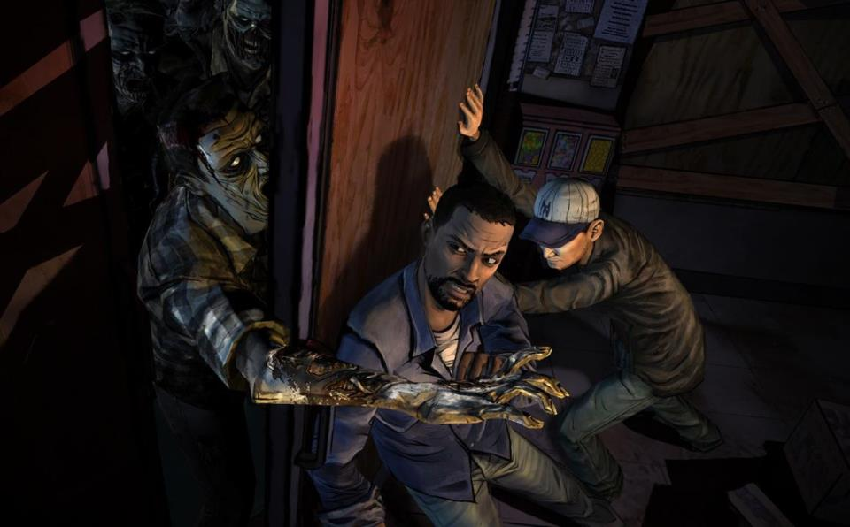
The Walking Dead
Available on: Mac, Windows, iOS, Android, PlayStation, Xbox… pretty much everything
Notes:
Games: The Walking Dead (Mass Effect) – Owning your choices, making a character your own, emotional content
So first up is one I recommended earlier: The Walking Dead, particularly Season 1 (if you’d like a session long rant on what was wrong with season 2, feel free to see me later on). It’s not for kids, and it’s definitely violent, but there aren’t a lot of other games out there that get simulating conversations and social dynamics (particularly social dynamics under stress) as right as this one does. It’s also a great example, as I mentioned earlier, of a game that uses what actually amounts to minimal choice to still let you feel like the character you’re playing is your own. Most of us don’t have the capacity to make every choice count or to give a large number of choices each time. This game shows you how you can be economical with the number of choices you give and still let the player feel that they’re in control. Finally, it’s just a fantastic example of telling a digital story that has huge emotional impact, and emotion is a storytelling tool many of you will want to leverage in your sims, particularly in ones that replicate soft skills.

Slide 38
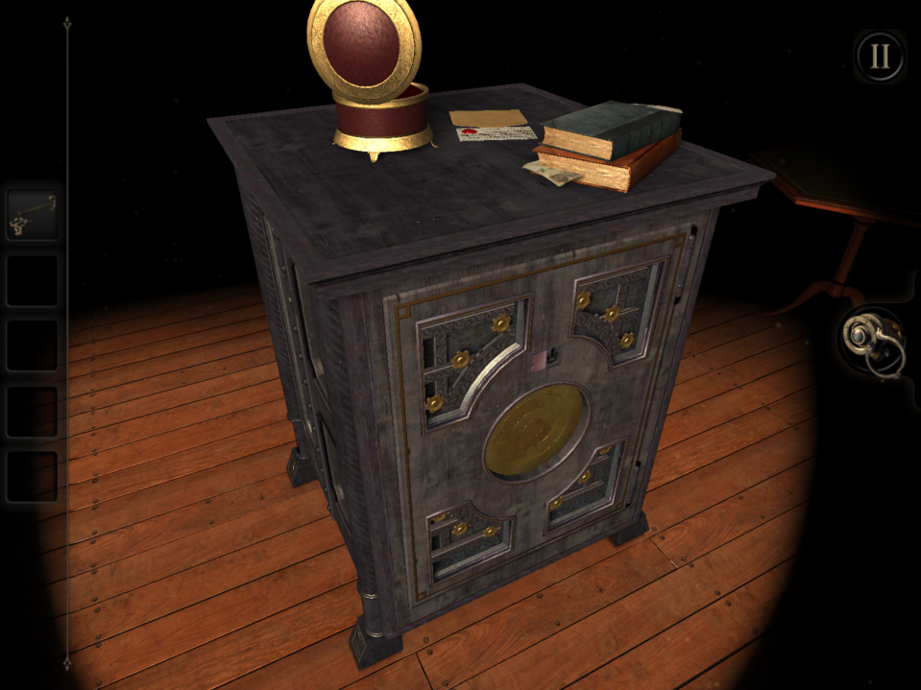
The Room
Available on: iOS, Android, Windows
Notes:
Games: The Room: Making interacting with a digital object feel real
So here’s a really different kind of game: The Room. You won’t be shooting zombies in this one, or even talking to another human being. Essentially, this is just a really clever, and kind of spooky, puzzle game. What I found so astounding about this game, and why I recommend you try it out, is how great it is at making digital objects feel real. A lot of the time when you interact with a digital object in a game or sim, the experience is simplified, or feels stiff and unreal. In The Room though, you’re constantly manipulating a 3-D puzzle box, and every time you interact with a lever, switch, button, or something else on it, the process of that interaction feels delightfully close to what doing that action in real life would feel like. Need to turn a key? You actually have to do a turning motion on the key end for it to work. Need to see another side of the box? You make a motion on the screen that’s just like manipulating an actual box around. Because it’s so good at simulating real actions, the game is both more intuitive and more immersive. If you need to simulate physically manipulating something, this game is great for inspiration.

Slide 39
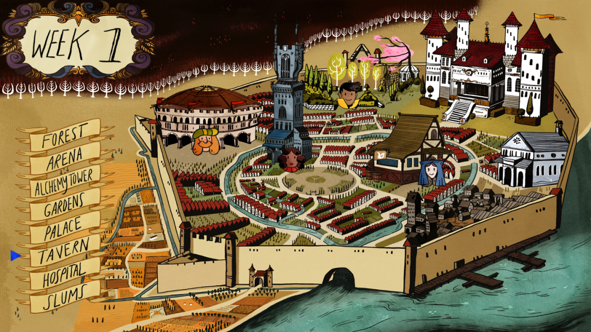
The Yawhg
Available on: Windows (No Mac, much to my sadness)
Notes:
Games: The Yawhg – Playing collaboratively, massive choice
http://www.theyawhg.com/
If you’re interested in collaborative play or if you like the idea of a myriad of choices that can drastically change a story, try out The Yawhg. It’s a four player game that technically you can play with less players… but it’s more fun with a big group. The story is simple: there are 6 weeks until an unknown danger will hit your city. The game play is simple too: you each play a character who has no idea any danger is heading your way. All you do is simply pick where in town you want to spend each of your six weeks, and then have a single additional choice once you get there. It sounds almost too basic to be fun, but the amount your tiny choices affect the storylines for both yourself and the other players is what makes this game kind of magical. Plus, playing with a group tends to be a hilarious event, and people commonly find themselves chatting and debriefing the short and long term results of their choices.

Slide 40
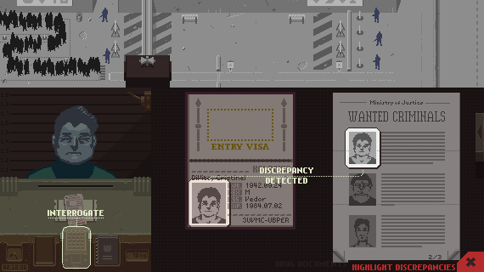
Papers Please
Available on: Mac, Windows, Linux
Notes:
Games: Papers Please – Recreating tasks, recreating tediousness to make the game immersive, using stress as a teaching tool
http://papersplea.se/
If you need to recreate tasks or if stress is a component of your simulation, do yourself a favour and try playing Papers Please. The premise sounds terribly dull: you’re a border guard at a fictional country that’s not unlike the USSR in the 80s. Your job is a tedious one: check the people who want to cross the border and decide whether they can enter your country or not. You get paid each day based on how accurately you followed the border crossing rules for entry. At first this is really easy, because the rules are simple and you can make a few mistakes. Then the rules get more and more complex, the amount of paperwork you have to keep track of becomes overwhelming, you get docked pay for making mistakes, and the amount of money you need to make each day to provide for your family becomes harder and harder to achieve. It’s astounding how stressful it gets and how this stress affects how you play the game and the choices you have to make to survive. Then the game adds additional elements: do you let a woman without the proper paperwork though so she can be reunited with her husband? Do you let someone you know is a criminal through when they have all the right paperwork. Do you take kickbacks for detaining people so you can keep your family alive? It’s amazing how a game with purposefully dated graphics and a tedious concept can both immerse you deeply in a world and honestly just stress you out a ton.

Slide 41
Spent
Available on: Web - playspent.org
Notes:
Games: Spent – Actual sim that mimics a game. Emotional content, showing the effects of choices
http://playspent.org/
So this is kind of a cross between a sim and a game but I wanted to include it anyway since it’s an excellent example of a simulation that’s clearly learned a lot from games. This is Spent, and it’s a poverty simulator. In it you try to live for a month on an extremely limited income and make the kind of choices each day that people in this situation often do. And it is hard… really hard. It’s not graphics heavy, but it carries a lot of emotional impact and is pretty immersive. It also, no surprise, is a good example of a sim that is build specifically to show the overall impact of a large number of choices. It’s a free game that you can play in any major web browser and it’s also relatively short, which makes it a perfect game to try out first or don’t have a gaming console.

Slide 42
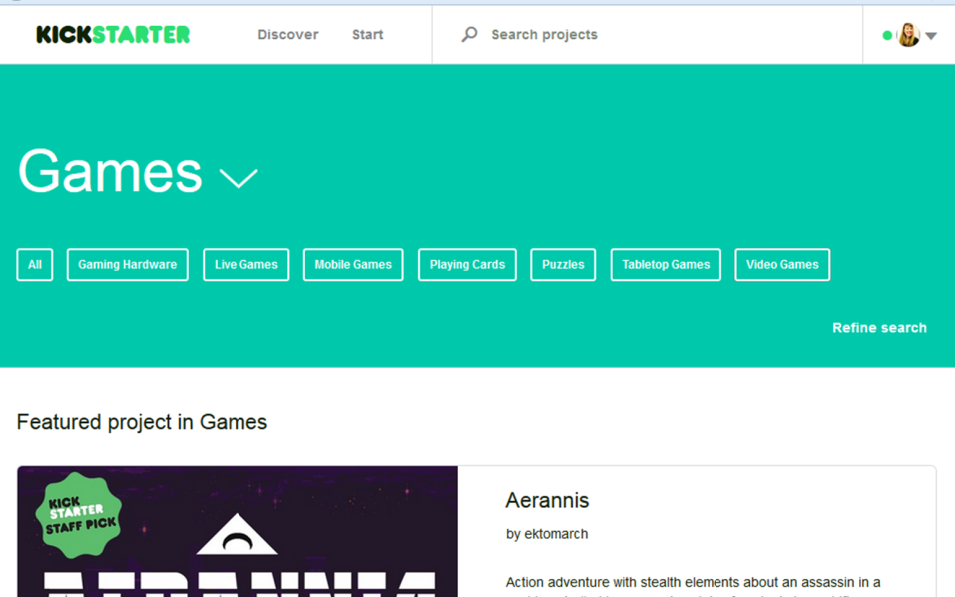
Back a game on Kickstarter
Notes:
Additional resources: Back a Kickstarter game
In addition to playing games, I’ve got two other suggestions for ways you can learn more about games… particularly about game development. First up, backing a game on Kickstarter is an amazing way to learn about what all goes in to developing a game. What’s really fantastic about most of the video games I’ve backed on Kickstarter is that you back them before they’ve been built. That means you’re there for a large portion of the game’s development, and most developers are fantastic about sending out regular development updates to their backers throughout what usually ends up being at least a year of building the game. Most of them are really upfront and honest about things like the thought they put into the gameplay, the things they’ve tried that didn’t work, and the way the game evolves from a rough proof-of-concept to a fully playable game. What these updates will teach you about game development are more than worth the price you pay for the Kickstarter, and it’s astounding how many issues I see these game devs encounter that resemble problems I’ve faced myself when designing sims and other kinds of training. Plus, you get a game at the end of it!

Slide 43
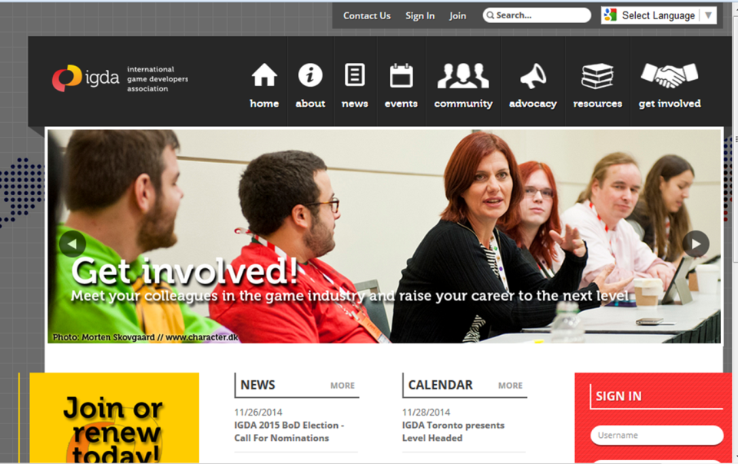
Tap in to the game development community Online or in-person
Notes:
Additional resources: Tap in to your local game development community (or the community online)
Finally, you should try tapping in to the independent game development community. Indie game developers are a lot like us L&D folks: they like sharing what they’ve learned with others. If you live in a large city, chances are you might have a local development community where you live. If not, there are a lot of great online game development communities out there that are open to anyone.
I’m really lucky in that I live in Toronto, which has this vibrant indie gaming scene, plus a number of organizations that let non-developers attend their events. The IGDA chapter in Toronto does these great talks that are a lot like the concurrent sessions you’re seeing here at TechKnowledge, only, obviously, on game development. They’re open to anyone, and most of them are either free or really cheap, and I’ve learned so much from devs talking about topics like using iterative design to create a game tutorial or how to use interior design techniques to make your digital environments feel more realistic. They’re pretty fantastic about filming their talks and posting them on YouTube, which means those of you who don’t happen to live in the same city I do can still enjoy them.
If you go into talks like these or online forums with an open mind that can find the connections between what a gam dev does and what we do, you can learn so much from these organizations and groups.

Slide 44
ADDITIONAL RESOURCES
http://biancawoods.weebly.com/GamesAndSims.html
http://e-geeking.blogspot.ca/
@eGeeking
Notes:
So, to wrap up, I hope you’re leaving today’s session with this: being fluent in playing games and the world of game development can absolutely make you a better designer of training simulations. Plus… it’s also really fun.
Finally, here’s the link I promised to the additional resources. It has a copy of this deck, along with the presenters notes, links to all the materials mentioned in this presentation, and more resources I thought you’d find helpful: http://biancawoods.weebly.com/GamesAndSims.html
I’m also constantly blogging and tweeting about learning, design, and technology, so feel free to check me out on Twitter or my blog.
Blog
http://e-geeking.blogspot.ca/
Twitter
@eGeeking

