Slide 1
Infographics
Telling Your Story With
Bianca Woods
@eGeeking
T
ext
ext
ext
Notes:
Welcome to “Telling Your Story With Infographics”. Today we’re going to chat about what exactly infographics are and how you can effectively create them to use in your own work.
Just as an upfront, as always I’ll be providing a link to a resource webpage at the end of this presentation. It’ll include links to all the resources I mention in this presentation, so if you happen to miss jotting down a concept or even just the name of a resource, don’t worry. I’ll be there in that site waiting for you.

Slide 2
Poll!
1
I don’t know much about them beyond the name
I’ve get the gist of how they work but aren’t sure how to make them myself
I’ve created my own infographics and want tips for refining them
What’s your experience with infographics?
2
3
Notes:
Before we get started, I’d love to know more about your own personal experience with infographics. With a show of hands, which group would you say you’re closest to?
Poll – What’s your level of experience with infographics?
I don’t know much about them beyond the name
I’ve get the gist of how they work but aren’t sure how to make them myself
I’ve created my own infographics and want tips for refining them
(make observations based on the results).

Slide 3
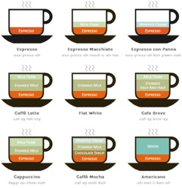
Infographics
…and why we seem to like them
Can simplify & compress content
Visually engaging
Less boring than plain tables & text
 | Espresso | Steamed Milk | Milk Foam
Espresso | 30 | 0 | 0
Caffé Latte | 30 | 50 | 20
Cappuccino | 30 | 35 | 35
Flat White | 30 | 50 | 0
Texttexttexttexttexttexttexttexttexttext
Texttexttexttexttexttexttexttexttexttext
Texttexttexttexttexttexttexttexttexttext
Texttexttexttexttexttexttexttexttexttext
Image Credit: Lokesh Dhakar
http://www.lokeshdhakar.com/coffee-drinks-illustrated/
Notes:
Infographics are practically everywhere these days and, when you sit and think about it, it’s not hard to see why they’ve become so popular. At first glance you could say that it’s because they’re simply more attractive than the average data dump, and you’re unlikely to get an argument there, but there’s more to it than just prettiness.
When done right, they’re spectacular at simplifying and compressing information. They can take an overwhelming sea of content and boil it down to a bite-sized and logically ordered high-level summary. Like this Cappuccino graphic on the left. I can instantly get the gist of what (and about how much) goes into my drink.
As well, they’re visually engaging. Infographics use graphics strategically, allowing them to take on some (or even all) of the load of communicating information, which it makes it that much easier for a viewer to grasp ideas and concepts. For instance, the full coffee infographic in the middle of the screen makes it much faster to compare different espresso-based drinks than just text could.
Finally, and this isn’t something we can overlook, they’re often much less boring that straight up text or tables. On the far right is a table of some of the exact same numerical data from the coffee infographic. And I’ll bet I know which one you find more interesting…

Slide 4
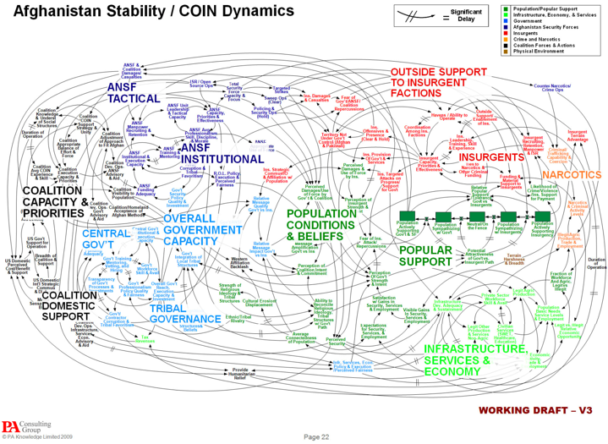
But not all infographics work Sometimes they’re a complete mess
Notes:
But I’m sure we’ve all seen infographics like the one on the screen here, a particularly memorable graphic from the US Army. Sure, there’s information represented graphically here, but it’s not actually clear at all. In fact, it’s a bit terrifying.
Infographics like these are proof that just because something’s visual, doesn’t mean it’s clear.
Graphic: http://www.nbr.co.nz/article/us-army-creates-world-s-worst-powerpoint-slide-122255

Slide 5
Poll!
Raise your hand if you’ve ever seen an infographic that just didn’t work
Notes:
So let’s try another poll here.
Raise your hand if you’ve ever seen an infographic or infographic-inspired experience that just didn’t work

Slide 6
Discussion
When you’ve seen weak infographics, what stuck out as why they didn’t work?
Notes:
So about the bad infographics you’ve seen? What in particular really stuck out for you as things that didn’t work?
(make observations based on the results).

Slide 7
Not all infographics are created alike!
What?!
Notes:
The truth is, and this will come as no surprise to you guys, infographics aren’t all perfect. Some of them are fantastic, but some of them are just plain bad.
So today what we’re going to do is help you learn to make infographics that don’t get in the way of the information you’re trying to share. We’re going to look at when you should (and shouldn’t) use them, break down what exactly makes a good infographic, and explore what you need to consider when making your own.

Slide 8
So when should you use an infographic?
To infographic…
…or NOT to infographic?
Notes:
So let’s get back to that first point: that there are times to use an infographic… and then there are times when it’s not the best idea.
An infographic is just like any other tool: you can’t use it for every situation. It’s just like the same discussions that we’ve had in the past about other shiny new tools for learning like eLearning, virtual classrooms, AR and VR and the like: these approaches are only effective in certain situations. Outside of those times, it’s like trying to use a hammer when what you need is a belt sander. You can’t actually do the job with the hammer… and trying to might actually make things worse.
But how do you figure out if what you’re trying to do might make sense as an infographic?

Slide 9
Tie together related data
Simplify large amounts of content
Tell a story that’s best told through data
Consider using an infographic
if you need to…
Notes:
There are a few situations infographics are perfect for.
The format lends itself particularly well to knitting together snippets of related data. You’ve probably seen this done well with the standard long infographic that shows a bunch of small facts that combine together to form a fuller narrative.
Another good time to break out an infographic is if you need to simplify a large amount of data into a core story. The process of making an infographic can help you narrow down what your key points are, and you can also use graphics to help simplify your content further.
Finally, infographics do a great job of taking a data-based story and presenting it in a compelling way rather than through just a bunch of numbers or paragraphs of text.

Slide 10
Use it just because it’s shiny & new
Need to share a linear narrative
Attempt to link data that actually isn’t connected
You’re better off using
something else if you need to…
Notes:
On the other hand, there are definitely times to avoid infographics and do something else.
For starters, and I’m sure I’m preaching to the choir here, but it’s a bad idea to use an infographic for the sake of using an infographic. Chances are you’ll bump into this with SMEs or clients where they want to use them because they’ve seen them around and like the look of them. As always, you want to check what they’re trying to accomplish before committing to an infographic.
Another time where an infographic isn’t the best solution is if you need to tell a linear story or scenario rather than show information. In a case like this, text, a video, or even a comic will do a better job.
Finally, infographics don’t work well as a means to link together data that actually isn’t well-related. You might have seen projects like this before where it’s honestly just a dump of unrelated data stitched together and wrapped in a pretty, visual shell that leaves you scratching your head as to what it all means together. Infographic design isn’t magic, though, and ones that just go through the motions of the approach don’t tend to resonate well with people.

Slide 11
Where do people tend to go wrong when they make infographics?
?
?
?
?
?
?
?
Notes:
So, let’s say you’ve definitely got the right subject for an infographic. Unfortunately, even if the topic is right, it’s still possible for an infographic to be a bit of a dud. Here are three of the more common, but fixable, issues I tend to notice in dysfunctional infographics.

Slide 12
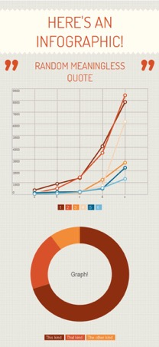
Unclear point
But what does it mean?!
Notes:
First up is confusion about what the point of the thing is supposed to be. Maybe it’s poor organization, a lack of context, or bad editing, who knows. But the end result is the same: you read to the end of the infographic but you still aren’t sure what exactly what the core point it’s trying to make is.
This is sort of the fixable version of the “unrelated data stitched together” problem I mentioned earlier. In this case the information, data, and facts do actually relate to each other, but they just haven’t been assembled and curated very well.

Slide 13
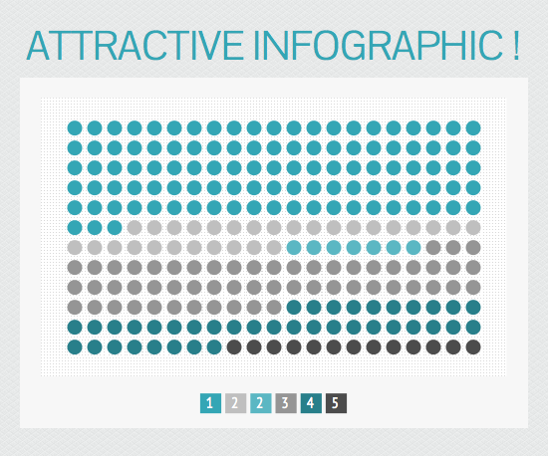
Data & information is poorly displayed
Well, that doesn’t tell me anything!
Notes:
The next misstep is having good data and information, but presenting it in a confusing way.
This commonly happens in one of two extremes: either there’s too little information, so people can’t interpret it properly or there’s way too much information, so people get overwhelmed. Either way, your audience isn’t actually getting the information you’re trying to present.
Another snag can be using the wrong visuals for the information you want to show. For instance, some types of graphs are just much better suited to specific types of data than others. Choosing poorly can muddle your message.
A related problem is the issue of misleading data. I’m not going to talk about it much since I’m working from the assumption you guys are all planning on using accurate information, but it’s at least worth a mention here. While your infographics might be soundly researched, there are some out there that show either inaccurate data or cherry-picked information, both of which are deeply misleading. If you’re planning on using or sharing an infographic created by someone else, it’s worth double checking their facts to make sure they’re actually accurate as depicted.

Slide 14
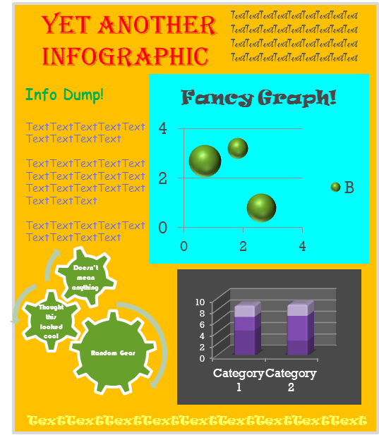
Confusing (or just plain ugly) graphic design
Ahhh! My eyes!
Notes:
Finally, you can get the plot and data all perfect, but if the graphic design is lousy your information will look confusing and unprofessional. Never forget that the second half of the word “infographics” is, well, GRAPHICS. You can’t phone this part in and hope for the best.
Now, no worries here if you personally aren’t a graphic designer. You can still create infographics, but you’ll likely need to lean heavily on some of the tips and tools I’ll be mentioning later on.

Slide 15
Discussion
How about great infographics? What about them stuck out as particularly effective?
Notes:
Okay, so enough about the stuff that’s lousy. How about the infographics that you’ve really enjoyed. What specifically about them stuck out as the reasons they were successful?
(make observations based on comments)

Slide 16
So what does a GOOD infographic have?
Clear narrative and point
Logical information
Well-designed graphics
How much pie have I eaten so far?
That’s some good looking pie!
a history of pie consumption up to this point of time
Notes:
So here’s what I think are the core things that make a good infographic.
First, you can quickly figure out what the point of the infographic is supposed to be and all the content reinforces that point. There’s also enough content to support that main idea, but not so much that it feels like a data dump.
Second, the information is all displayed in a logical form. Each graphic or chart has just enough information for you to understand what’s going on, but isn’t trying to do too many things at once.
Third, the overall visual design is clear and polished. It’s got an appropriate aesthetic, consistently used colour scheme, and readable fonts. It also doesn’t look cramped.
It’ll likely surprise no one to know that what we’re going to do for the rest of this session is explore easy tips and tricks for how you can make sure your own infographics meet all of these standards.

Slide 17
What’s my story?
Essay Approach
Research Approach
Data & Info
Topic
Notes:
The first part of any successful infographic is a clear story or, if you want to go back to essay writing terms, thesis. This is the core point of your infographic and it’s what’ll provide the structure for everything else.
Coming up with a good infographic story is honestly a lot like writing an essay or article. You can arrive at your story one of two ways. You can start with a general idea you’d like to talk about and then research related data to help you clarify your topic even further. This is probably what a lot of us did when we were writing essays for school.
(cue animation)
The other way you can find your story is to start with a large amount of data and then sort through it find the story in it. The is more of the research report approach and it’s a great way to use the process of creating an infographic to help you make sense of a bunch of raw data.
Regardless of the way you come to your story, remember that this is magnetic north for your project. All the information you include in your infographic needs point strongly to this idea or your project will go off course.
Now, it’s important to note that not all infographics have the same amount of story to tell. Some explore a large volume of information on a topic, like the long skinny infographics we’re so used to seeing. Others, though, share a smaller snapshot of content. For instance, one of my favourite infographics is a single image that shows how many times common online actions, such as Facebook status updates and Firefox downloads, happen every 60 seconds. It’s comparatively short, but still quite effective. Whatever your infographic’s length is, that’s fine as long as it’s making a clear point and supporting it.

Slide 18
Can I thoroughly support my story?
Main Idea
Data
Data
Data
Data
Data
Data
Data
Notes:
So, on the topic of support, once you’ve figured out what your story is, you need to be sure you can back it up. Infographics are an information-based medium, so you need to make sure you have real facts and data that you can use to support your core idea.
If you’re coming at this from the research report approach, this is mostly taken care of. You’ll just want to look through your supporting data carefully to make sure there aren’t any holes in your conclusions or important facts you’ve overlooked.
If you’re using the essay approach, though, this is where you’ll have to invest time and effort to research the facts that will support the point of your infographic. At this stage, just collect anything and everything that might contribute to the story you’re interested in telling. It’s better to begin with too much and then edit down then to not have enough.
During this process you may find you need to revise your main idea so it more accurately reflects what your research is telling you. This is perfectly fine… even expected. In fact, this research may even expose you to data that tells you your original story idea is flawed or even incorrect. In this case, scrap it, start again, and be thankful you caught the problem early.

Slide 19
The hard task
of sorting
SlightlyRelated
Somewhat
Related
Mostly Related
Strongly Related
Data
Data
Data
Data
Story
Data
Data
Data
Data
Data
Data
Data
Data
Data
Data
Data
Notes:
Once you have a bunch of data collected, you have to go through the hard process of actually sorting through it all.
Infographics are supposed to be easily digestible collections of bite-sized information. That means that for them to be successful, you can’t possibly show every interesting piece of information that you find. If you need something that provides more detail than this, perhaps an infographic isn’t right for this particular project.
To keep your infographic clean and concise you’ll need to strip down your data to just the key points you want to convey. Nothing more. Nothing less.
There are two angles you’ll want to evaluate information from. First, you need to approach it from the perspective of the information on its own. To do this, continually ask yourself if each snippet of info you’re choosing to share is strongly connected to the core story of your infographic. Be brutal and drop anything that isn’t contributing enough valuable and unique content.
Next, you need to look at your information from the perspective of how all of your data comes together to tell a cohesive story. Edit out any snippets of information that are covered better elsewhere and fill any data holes that you notice you have.
After this sorting you should have a collection of information that is sleeked down to the basics, tells a complete story, and doesn’t repeat itself unnecessarily.

Slide 20
Try it out for yourself
Topic
“How conferences help you build your skills.”
Notes:
So now we’re going to try some of this sorting out for ourselves. I’m going to give you a hypothetical infographic scenario and some of the data that was collected on the topic. You’ll then get to weigh in on what should stay, what should go, and why.
So our set up is this: You’ve been asked to put together an infographic on how conferences can help people in your field build new skills and polish existing ones. You’ve collected quite a lot of information on the topic and are now sorting through your research and deciding what is going to make the final cut.

Slide 21
What do I keep?
“How conferences help you build your skills.”
1.
The percentage of people from your company who attended conferences over the past 5 years
2.
Quotes from employees about what memorable things they learned at recent conferences
3.
A set of statistics on how learning professionals rate the value of conferences
4.
Study results on the value of conferences for people in executive roles
5.
A chart showing how the number of conferences has increased over the past 10 years
6.
A list showing a selection of industry conferences and when during the year they’re held
Notes:
So let’s try this out. Here’s a selection of some of the information you’re evaluating. Some of this has to go. But what? Note: there’s not necessarily a right or wrong answer for some of these.
The percentage of people from your company who attended conferences over the past 5 years
Quotes from employees about what memorable things they learned at recent conferences
A set of statistics on how learning professionals rate the value of conferences
Study results on the value of conferences for people in executive roles
A chart showing how the number of conferences has increased over the past 10 years
A list of a number of industry conferences and when during the year they’re held
Now let’s got through these and talk about what we want to keep and what we can cut.
(Go through each item in the list and ask people to vote on whether it should stay or go. Ask for volunteers to talk about why they made their choice.)
Before we move on, do you have any more questions about working out the story in your infographic?

Slide 22
How exactly do I display my content?
Text
Notes:
Once you’ve sifted through your information and picked what specifically you want to include, the next big decision you have to make is how exactly to display each snippet of information. There are all sorts of ways to use visuals to show content, from graphs and charts, to maps, to images, to text and numbers. These options aren’t all perfectly interchangeable though. What works quite well for showing one kind of fact might be terribly confusing for displaying another.
Skillfully choosing the best way to display your information is yet another way to make sure your infographic is successful.

Slide 23
Communicating with graphs
Notes:
So one of the most commonly used ways to display information in an infographic is graphs. Sometimes these graphs look themed, such as a pie graph of popular pizza flavours that’s actually in the shape of a pizza, and sometimes they’re simple and unadorned. Regardless of how they’re displayed, though, they accomplish the same thing: sharing numerical data in a way that’s easier to ingest than a list of numbers and also provides much more context.
Like I mentioned earlier, though, graph types aren’t interchangeable. You can actually muddle your message if you use a type of graph that’s poorly suited to the message you’re trying to convey. For instance, the graphs on the screen right now show the exact same data, but they both tell a very different story about the information. The column chart on the left makes you much more inclined to compare one month’s results to another. The pie chart, on the other hand, is likely to make you think about how each month’s results contribute to the yearly total.
Because the graph type itself influences how people perceive the data you’re presenting, let’s take a look at the most common kinds of graphs and talk about what each one is best suited for.

Slide 24
Types of graphs
Type:
Bar/Column
Best Suited For:
Comparing different items/categories
Showing changes over time
Type:
Pie
Best Suited For:
Showing the portions of a whole.
Capturing a moment of time
Type:
Stacked Bar/Column
Best Suited For:
Comparing different categories while also showing the components of each category
Type:
Line
Best Suited For:
Showing results over time.
Comparing the results from several sources over time
Type:
Scatter
Best Suited For:
Showing patterns between two variables throughout a large number of data points.
Units Sold (in millions)
Jun
Dec
Notes:
We’ll start with the Pie Chart. Pie charts are great for times when you want to focus attention on how different things come together to form a whole, like this breakdown of a day on the screen now. Also, they work well when you only need to show the rough gist of those percentages to make your point. Also, the pie graph is a great graph to use when you need to capture snapshot of data from a set period of time.
On the negative side, this clarity of a moment comes at the cost of being able to show results over time. If that’s what you want to show, avoid pie charts. As well, pie charts can easily become hard to read when there’s too many pie wedges in a single chart. Finally, because pie wedges are hard for viewers to measure precisely, you’ll need to label your wedges with the exact percentages if you need to show precise data, which in some cases can look cluttered.
(cue animation)
Next up is Bar and Column charts. This is a particularly flexible graph, great for situations where you want to compare a number things or show how results change over time. That said, it has some weaknesses as well. If the differences between each column are quite small or large, it’s difficult to view those subtleties well. Another issue is number of bars or columns. Too many and the graph easily becomes too busy for the viewer to interpret. Finally, because the bars are spread out next to each other rather than grouped as a whole, they’re not great for showing how items come together to form a whole.
(cue animation)
A cousin to the last graph type is the Stacked bar or column graph. This graph is spectacular for comparing multiple categories while also comparing the components that go into each category at the same time. A common place you might have seen graphs like this is in company sales documents, where you view the total sales along with how much each person or business group contributed to that total. If you choose to simplify this type of chart to a single column or bar you can use it in the exact same situations you might use a pie chart.
While these types of graphs are informative, the sheer amount of data being shown at one time can quickly become overwhelming for viewers. Because of this, it’s best to avoid this type of chart for any project that doesn’t strongly benefit from showing categories and their components at the exact same time.
(cue animation)
Now let’s look at line graphs. These are your best bet for quickly showing viewers how a result changes over time. In particular, they’re stronger than bar and column graphs for showing a large number of data points cleanly. Another feature they have over bar/column graphs is the angle of each line between points. It does a fantastic job of quickly communicating to viewers whether change is gradual or sudden, which you should use to your advantage if this is a point you want to make. You can also plot multiple sources of results, which can be helpful for comparing and contrasting them.
That said, showing multiple items on a line graph tends to work best when you want to show multiple results over the exact same time period. It gets messy and even misleading if, say, you want to compare one company’s sales results from January through to March to another’s from July through December. Another issue can be graphing too many sources of data. The more data sources there are, the harder it can be to read the graph, particularly when results crisscross over each other.
(cue animation)
If you need to show patterns in the relationship between two variables (for instance, between competing product sales over the year) a Scatter Chart can be helpful. This can be the easiest way to communicate the correlation between two things. For example, in the example above, you can see that sales of all brands of zombie repellant appear to be related to the time of year. This graph is a fantastic way to explore how large amounts of data relate to each other, but it’s only useful if the two variables actually have a relationship to each other. Doing a scatter chart of, say, sales of snowboards and the worldwide bee population over a year is unlikely to tell you anything useful. In fact, it might accidentally lead people to believe there’s a connection between two topics that actually isn’t there.

Slide 25
Misleading information
Missing and Confusing Labels
Choosing the Wrong Graph Type
Inconsistent or Misleading Design
25
20
15
Time on the job
10
8
6
4
Comparing Brands Over Time
2
Notes:
When you’re using graphs it’s important to be aware of the way your data can become misleading.
One of the more common graph problems is missing labels. For instance, in the example on the left there’s no actual way of telling what each colour on the column chart actually means. Always make sure every variable is labeled and that label is easy to find. Confusing labels are also an issue, particularly when they leave out the unit of measurement. It’s all fine and good to say the y-axis in that same example refers to time on the job, but how is it measuring time in the first place? Years? Months? Weeks? Hours? Check to make sure every label includes all the information a viewer needs to interpret it.
Now, as we discussed earlier, choosing the wrong kind of graph can interfere with your content. Mistakes with graph types can actually make your content incomprehensible or cause people to take the wrong conclusions from it.
A problem that can erode confidence in your graphs is inconsistent or completely misleading graph design. For example, look at the graph on the right. At first glance you’d likely assume that each one of those horizontal lines in the background represents an equal increase, but look again. The labeling goes up in increments of two for awhile, then randomly jumps to increments of 5.This makes the sections at the top of the column look like they represent less than they actually do. These kinds of errors don’t just make your content confusing, they’ll also make your audience feel lied to if they discover the error, regardless if it was a purposeful manipulation or just an honest mistake.

Slide 26
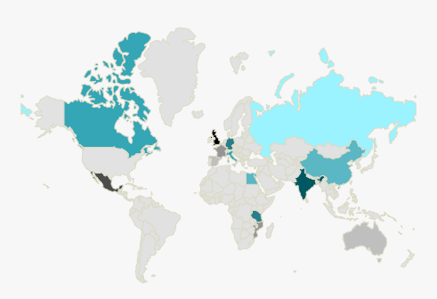
Other ways to show information
Titles
Here’s a bunch of text that gives this infographic more context
When asked what drink was their favourite, the 14 surveyed customers replied…
90%
55%
73%
Images
Maps
Text
“Adding a related quote here”
Colour
Don’t know what that means
Aren’t sure why they should care
Want to run away
90%
Coffee
Some info about this statistic
Tea
55%
Pop
Some info about this statistic
Water
73%
Some info about this statistic
Juice
Some text to explain why this graph is important
Notes:
Now, graphs obviously aren’t the only way you can show information. Here are a few other options to consider.
Never write off text. While you don’t want an infographic to be all text, text used strategically is incredibly helpful. It’s great for adding context, both at the beginning of the infographic (where you can use it to explain the point of the whole thing) and throughout the individual facts to explain information or speak to how it connects to the main topic. It’s also helpful for showing snippets of numerical data, like a few carefully chosen percentages or survey results. Finally, you can use it to add meaningful quotes. Text is great for helping to knit together content and adding additional detail. Just make sure it’s easy to read, both in size and colour.
(cue animation)
Another great tool is graphics. Sure, they’re great for adding a bit of visual flavour, but they’re also good for quickly illustrating concepts and themes. Keep your eyes out for times where a visual can explain a point faster than text or numbers.
(cue animation)
If you need to show geographical data, from countries, cities, neighbourhoods, or even just your office floor, try using maps. They’re an effective tool, particularly when they’re partnered with labels or colours.
(cue animation)
Speaking of colours, they’re another valuable tool to have in your arsenal. Beyond just the aesthetic appeal, you can use them to create graph-like images like the one on the screen, highlight maps and zones, or even theme different infographic subtopics.

Slide 27
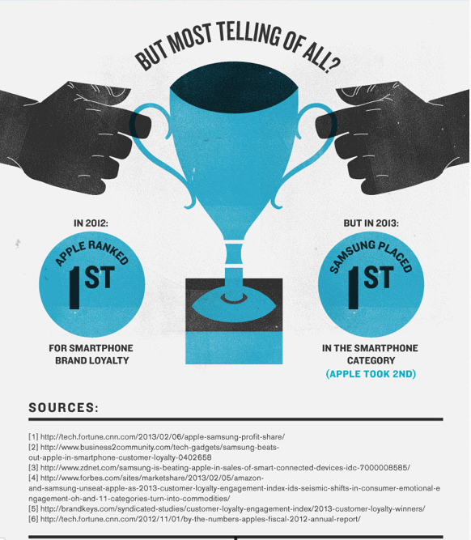
Cite your sources!
Infographic credit: http://infographiccommons.com/view/could-samsung-take-down-apple.html
Notes:
Now, when you’re presenting facts it’s always great to give people the chance to double check your information. This reassures your audience that you didn’t just make these facts up… you actually got them from a trustworthy and reputable source. This is why it’s a great idea to cite your sources where it’s possible, and in particular when you’re displaying content that’s surprising or contentious.
There’s a simple method that’s been established for citing sources in infographics: simply list links at the bottom of your infographic. This makes it easy for viewers to find as well as simple for them to check.
http://infographiccommons.com/view/could-samsung-take-down-apple.html

Slide 28
What isn’t working?
During a recent survey, participants replied:
1-100
101-200
201-300
301-500
501-700
750-1000
Notes:
Okay, now that we’ve pointed out best practices for showing data, let’s take a look at two examples of poorly displayed content and talk about how we could fix them.
(cue animation)
So here’s a pie chart that could stand to be a bit clearer. What are some suggestions you have for how we could change how we’re showing the information to make it clearer. (look for comments about too many pie wedges, wedge colours are too similar, wedge labels are too small to read)
(cue animation)
Let’s try this graphic. (Look for comments asking why the stick people are different sizes, noting that some of the colours are too similar to differentiate easily, questioning why the colour table goes up in unequal increments, wondering what the replies are measuring, and asking what the survey question they are responding to is)
Excellent. Now, before we move on do we have any questions about displaying content?

Slide 29
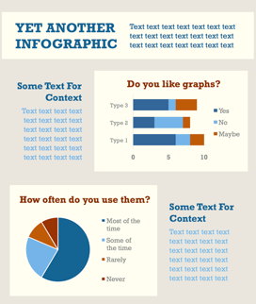
YET ANOTHER INFOGRAPHIC
Text text text text text text text text text text text text text text text text text text text text text
What should it look like?
Some Text For Context
Do you like graphs?
Text text text text text text text text text text text text text text text text
text text text text
text text text text
How often do you use them?
vs
Some Text For Context
Text text text text text text text text text text text text text text text text
text text text text
text text text text
Notes:
Creating a good infographic requires more than just showing basic content; it also includes using graphic design smartly. Basic graphic design is at the core of every compelling infographic and it does a lot more than just make the project “look pretty”. It also makes the information easy to view and helps everything look like it belongs together.
If you’ve already got a graphic design background, you’ve probably got this down pat. If you’ve got little to no experience with graphic design, though, here are a few good tips that can make your work look substantially more pulled together.

Slide 30
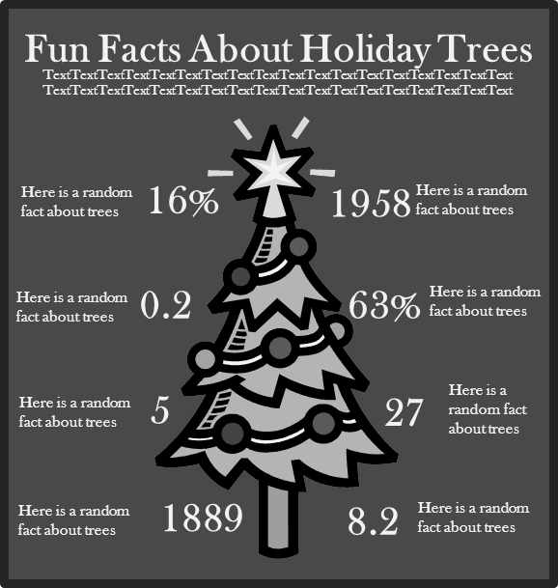
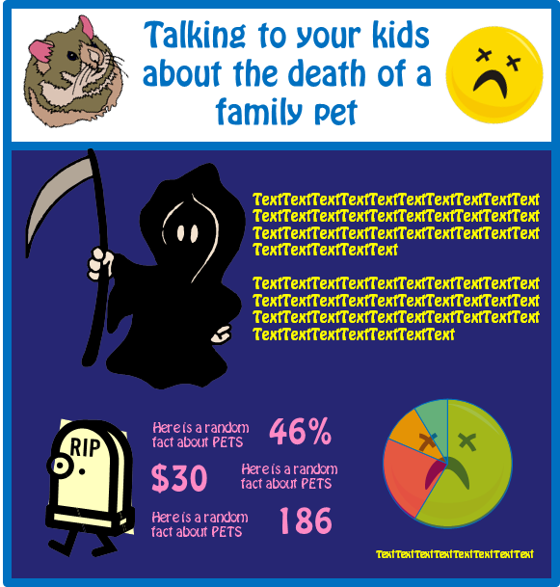
Committing to the right aesthetic
Notes:
Start by committing to a clear overall aesthetic that matches the subject of your project well. Aesthetic sounds like a terrifying design term, but in it’s heart it simply means the look and feel of the project. This is honestly just the same kind of design choices you may have made in the past on projects like eLearning, handouts, or slide decks and the like. Much like those projects, the particular aesthetic you choose has the ability to emphasise your core story or derail it.
Because infographics are such a visual medium, getting the look and feel right is particularly important. That means you can’t just go with your whims when making design choices. Take a good look at the examples on the screen. Now, they’re obviously comically bad mismatches, but the point they make it still valid: a mismatch is incredibly distracting. When you’re making these design choices, continually ask yourself if the choice you’re making matches your topic. It’s also good to make sure it matches the needs of your intended audience too.
Also, once you’ve decided on a particular aesthetic, make sure to stick with it consistently throughout the infographic.

Slide 31
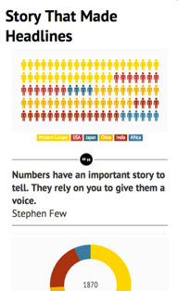
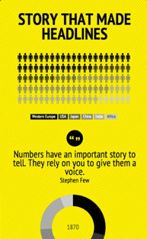
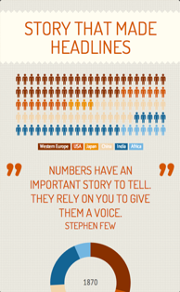
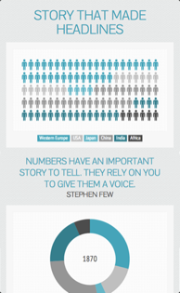
Colour Scheme
Main Colours
Main Colours
Main Colours
Main Colours
Notes:
A core part of your aesthetic is going to be choosing your colour scheme, or colour palette.
Using a bunch of different colours haphazardly ends up looking messy and unprofessional. It also can interfere with your overall aesthetic. That’s why it’s important to choose a set colour scheme for your infographic. This will be small selection of specific colours that you use consistently throughout your entire document.
Select a few colours that look good together, all of which match your overall aesthetic, and you’re set. For those of you less comfortable putting together colour schemes on your own, don’t worry: I’m going to include some resources on this topic on the session resource site.
Now, when you’re choosing which colours to use where, keep in mind the idea of contrast. Putting, say, medium green text and graphics on a slightly lighter green background isn’t going to be easy to read. Stronger colour contrast is incredibly useful for readability.

Slide 32
Picking the right fonts
Notes:
Another look and feel decision you’ll need to make is the fonts (or typefaces) that you choose to use in your infographic. Fonts each have their own visual aesthetic, so it’s important to choose ones that match the look and feel of your infographic. While an in-depth study of typography can help you understand the subtle detail of the style of each font, even an untrained eye is pretty good at picking out the gist of how a font makes you feel and what it reminds you of. Use your gut feeling about a font to decide if it fits your aesthetic or not.
When you’re picking fonts it’s smart to choose just one or two that tie in nicely with the theme of your infographic. Why that number? Because it’s very easy for three or more different fonts on a single project to look messy or disconnected. If you’re not a trained graphic designer, it’s best to keep it simple and just stick to no more than two fonts. Personally, I find using one font for headings and titles and then another for my body text to be an easy way to keep everything tidy and consistent.
No matter what fonts you choose, always make sure they’re at a readable size on your infographic. Also, remember that not all fonts are readable at all sizes. Do a quick eye check to make sure the size you’ve made your fonts is actually legible in the situations your infographic will be viewed in.

Slide 33
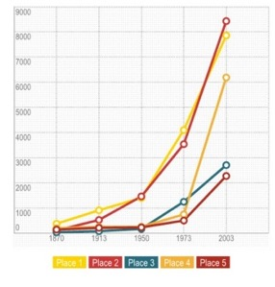
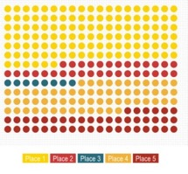
Keeping everything from looking cramped
Notes:
Another easy win with design is to avoid cramping your content by leaving enough whitespace between your design elements (like text, titles, graphics, and charts). Sometimes people want to cram as much information in an infographic as possible, which leads to the kind of project on the screen right now. The facts and design are generally good, but everything is way too close together for comfort. Cramped infographics like this are hard to read and tend to make the information seem overwhelming.
(cue animation)
Leaving just a bit more empty space makes it a lot easier to read and ingest. In some cases, spreading out your information more may mean you need to make your infographic a bit larger. That’s definitely okay in most cases. In instances where you can’t adjust the size of your overall infographic, for instance, if you’re designing for a particular print size, either shrink your design elements down just a bit or remove one or more of them to gain space.

Slide 34
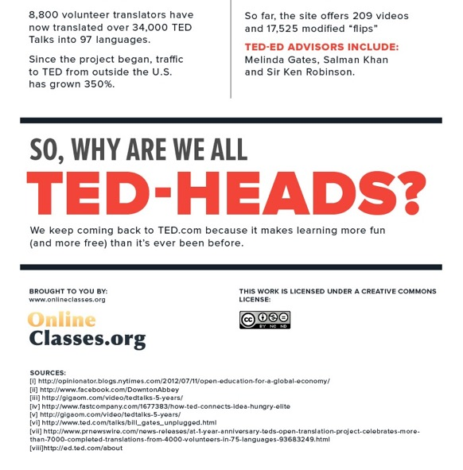
Contact & license info
Infographic credit: http://infographiccommons.com/view/tedtalks-info.html
Notes:
Finally, great infographic design means including a way for people to know who made the infographic and how it can be share and used, particularly if it may be shared outside your organization.
Sure, you may originally post your infographic somewhere where it’s clear who it belongs to, like a branded website or your own social media feed. Because of how infographics tend to be reshared, though, means they’re often removed from their original context. You wouldn’t believe the number of infographics I’ve seen on Pinterest and Twitter that have no easy way to track them back to the original person or company that made them. That’s why it’s always a good habit to include some sort of credit or branding directly on your infographic, typically at the bottom of the graphic. Include your name or your company’s, as well as a way to get in touch with you, such as a website, email address, or Twitter handle.
The bottom of your infographic is also a good place to include any licensing information you may want to release your infographic under, such as a Creative Commons license.

Slide 35
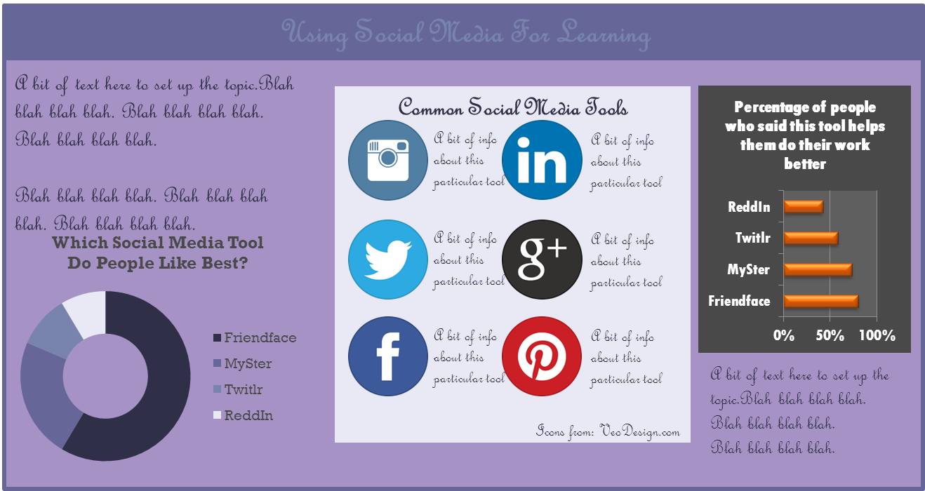
What isn’t working?
Notes:
Okay, let’s try another critiquing activity. Imagine your co-worker handed you this infographic they made on using social media for learning. They told you they know the visuals aren’t working entirely, but they’re not quite sure why. Ignoring the filer text, take a critical look at this infographic.
What do you think isn’t working from a visual perspective and what would you do to fix it?
(note colour scheme and font choices don’t match the theme of social media, squishing up of sections against each other, the title text colour being hard to read on the similarly coloured background, the chart on the left that doesn’t match the aesthetic of the rest of the infographic, the main font type just being plain difficult to read in general, and the lack of contact information anywhere on the infographic).
Great. Before we move on, do we have any questions about design?

Slide 36
How can I
find out more?
Hmm… give me ALL the resources!
Notes:
So those are the basics of putting together great infographics. Now, eventually you’re all going to have these basic ideas mastered. Because of this, I thought I’d also pass on a few suggestions for resources you can use to build your infographic skills even further.

Slide 37
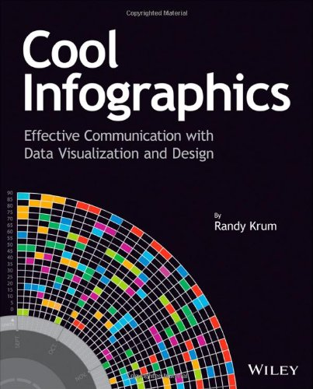
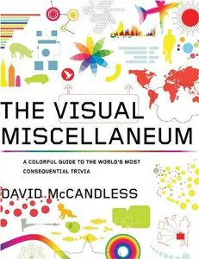
Books
Cool Infographics
Randy Krum
White Space is Not Your Enemy
Kim Golombisky
Rebecca Hagen
Information is Beautiful
and
The Visual Miscellaneum
David McCandless
Notes:
There are quite a lot of great infographic books out there, but I’m just going to focus on a handful that I think are good starting points. First up is these two collections of infographics by David McCandless. They’re both great for skimming through strong examples and getting inspiration.
(cue animation)
Now, if you want a book that will give you specific guidance on making infographics on your own, definitely check out this book, Cool Infographics. It’s full of step-by-step advice and techniques for making successful infographic projects and does a nice job of further breaking down a lot of the topics we chatted about today.
(cue animation)
If you find yourself wanting to build a better understanding of basic design, then pick up Whitespace Is Not Your Enemy. I continually recommend this book as a great resource for people new to design techniques. The book is quite thorough, but it’s also written in a way that’s simple and accessible for non-designers.

Slide 38
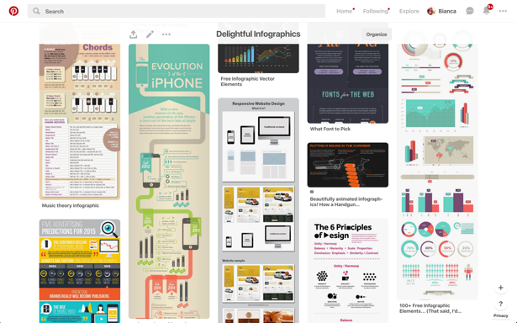
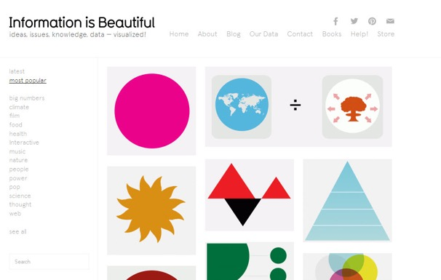
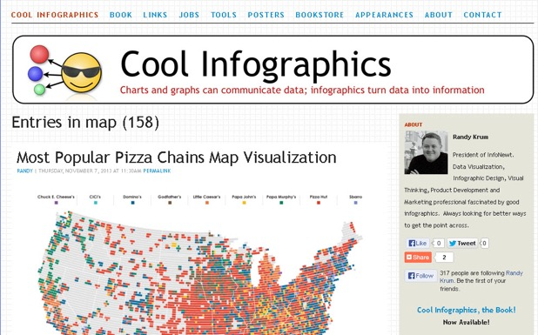
Websites that show great infographics
www.informationisbeautiful.net
www.coolinfographics.com
Pinterest
Notes:
Moving on to websites, here are a few of my favourites for inspiration.
http://www.informationisbeautiful.net/
The Information is Beautiful website is a helpful resource, particularly because it’s so transparent about the source data and thought process behind many of the infographics on the site.
(cue animation)
http://www.coolinfographics.com/
Another great site for learning more about how infographics work is Cool Infographics (and yes, this is the second website that connects back to a book I just recommended). This site takes infographics and then critiques them, commenting on both the aspects that don’t work as well as the portions that do. It’s a great way to learn from examples and non-examples.
(cue animation)
Pinterest
Another good option for getting inspired is Pinterest. There are absurd amounts of infographic on that site, admittedly of varying quality. But it’s a great place to look for inspiration. It’s also a handy place to collect the infographics you find other places. I actually have a Pinterest board where I pin any infographic I bump into that I think is particularly fantastic, and when I’m looking for inspiration I can actually go straight to that board knowing it’s full of good examples already.
http://sixrevisions.com/graphics-design/40-useful-and-creative-infographics/

Slide 39
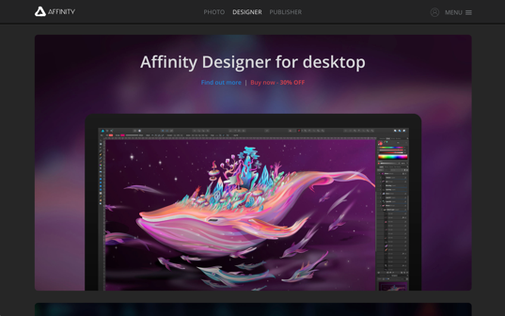
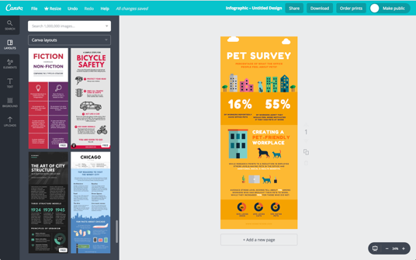
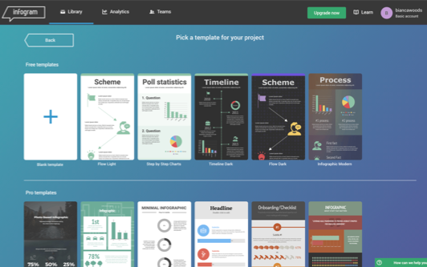
Tools for
creating your own
Canva
PowerPoint
Infogr.am
Adobe Illustrator/Affinity Designer
Notes:
Finally, let’s chat about some tools you can use to help put together your own infographics.
https://infogr.am
Now, if you want to make an infographic on your own but don’t have a lot of visual design skills, I highly recommend checking out a web tool called infogr.am. This site gives you both pre-built layouts as well as drag and drop charts and graphs. You can then input your own data into these templates to customize them. It’s easy to use and a good solution if you already have content and just need a polished way to show it. There’s a free basic plan, but if you’re using it a lot you might want to bump up to the monthly subscription to get access to more options.
(cue animation)
https://www.canva.com/
Canva is another fabulous template-based tool for creating simple infographics. Because it has a lot of free options and is easy to use, lots of people in L&D are already using it to create custom graphics. This is just yet another good use for the tool. Its templates have even more customization options than Infogr.am, although not all of them are fantastic so you’ll want to be picky with what you choose to use from it.
(cue animation)
I continue to sing the praises of using PowerPoint for putting together graphics. It allows you to easily define colour schemes and font defaults, you can create decent-looking graphs in it without much fuss, and you can even use some of it’s hidden features to create your own graphics (like I did with all the stick guys in this presentation). Plus, there’s a pretty good chance you already own it and have a vague sense of how it works. It’s not remotely its intended use, but it’ll get the job done decently well.
(cue animation)
https://www.adobe.com/ca/products/illustrator.html
https://affinity.serif.com/en-gb/designer/
Finally, you can go with what the pros use for this kind of work. Adobe Illustrator is a useful professional-level tool for putting together infographics, as is Affinity Designer, which is a similar piece of software but is MUCH more budget-friendly. They’re more complicated to learn how to use, but they have the most flexibility for what you can create.

Slide 40
Additional Resources
BiancaWoods.weebly.com/infographics.html
BiancaRWoods@gmail.com
@eGeeking
Notes:
So that was our introduction to infographics. When you use them in the right situations they’re incredibly compelling tools for communicating information, which makes them a great tool to have in your back pocket.
Now, as promised, here’s a link to the resources site I put together for this presentation. It’s got links to all the resources I talked about today, plus a few more I thought you’d like. As an added bonus, it also has a copy of this slide deck along with my presenter notes.
You’ve also got my Twitter handle and blog address here as well. I’m a total dork about all things design, so if you want to chat further about infographics, feel free to contact me at either of those places.
Now, before we finish up, do we have any questions?

